Slide 1
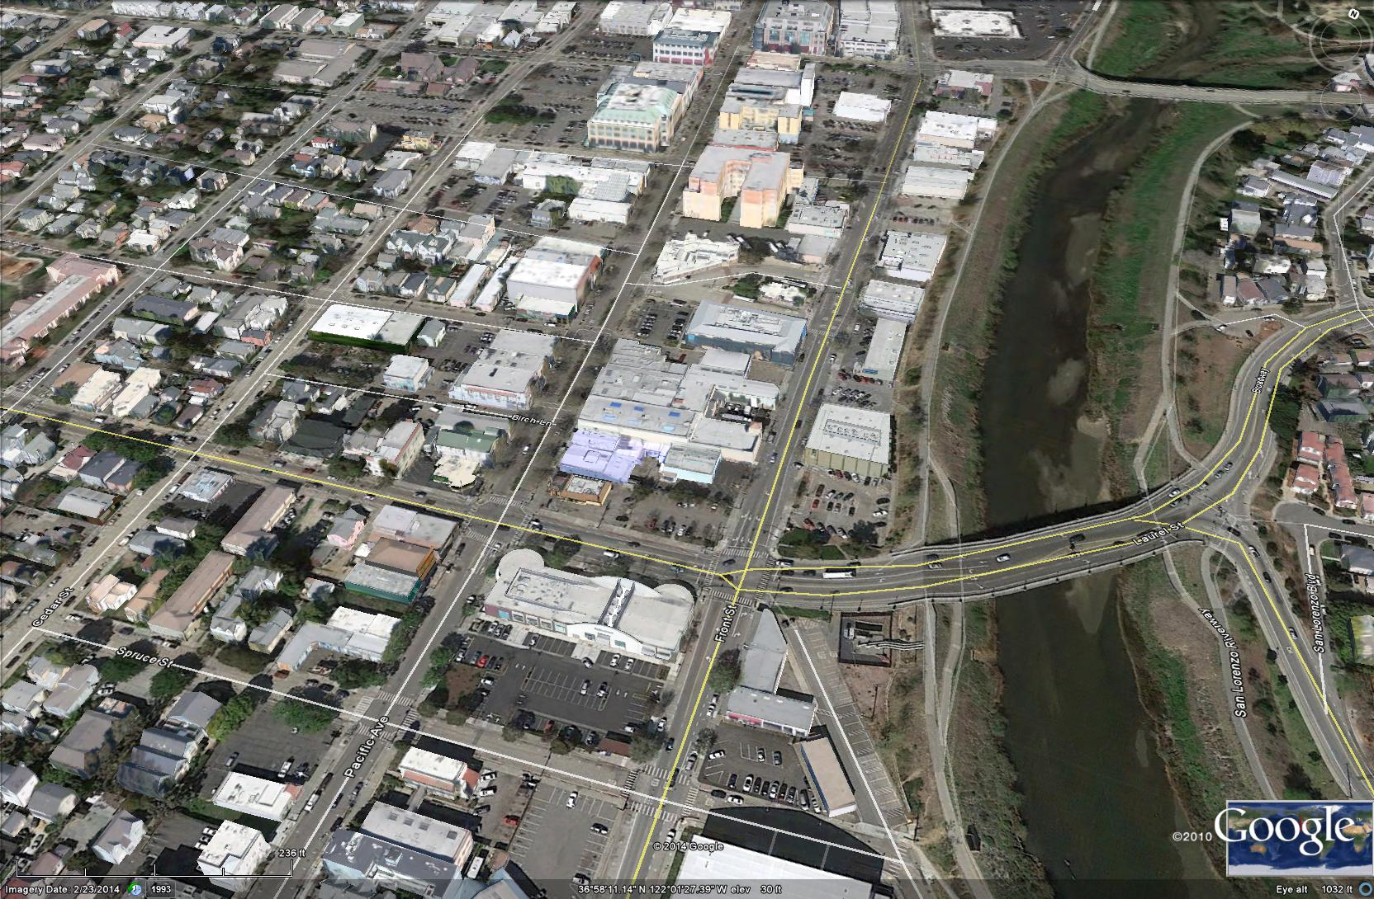
Expansion of the Downtown Recovery Plan’s
Additional Height Zones
Santa Cruz City Council
May 10, 2016

Slide 2
Presentation and Discussion
  Background and Purpose of Changes
    Planning Staff
  Presentation of Recommendations
    Boris Dramov, ROMA Design Group and Jim Adams, McCann Adams Studio
  Summary of Planning Commission Ad-Hoc Downtown Committee
    Peter Kennedy - with additional input from Mark Mesiti-Miller, Christian Nielsen and
    Mark Primack (former Commissioner)
  Public Comment
  Discussion by Council

Slide 3
Background of Proposed Changes
  2010 River/Front Lower Pacific Avenue Design Guidelines and Development Incentives study completed
  METRO Pacific Station – Multi-year Public Process to review development alternatives
  2014 City Council direction to work on Massing Study in contextual way and include Front Street properties
  2015 (May - July) Planning Commission discussion of Odermatt Group Massing studies and field walk of area
  2015 (December) ROMA Design Group presentation to PC
  2015 (December) PC Ad Downtown Hoc Committee formed

Slide 4
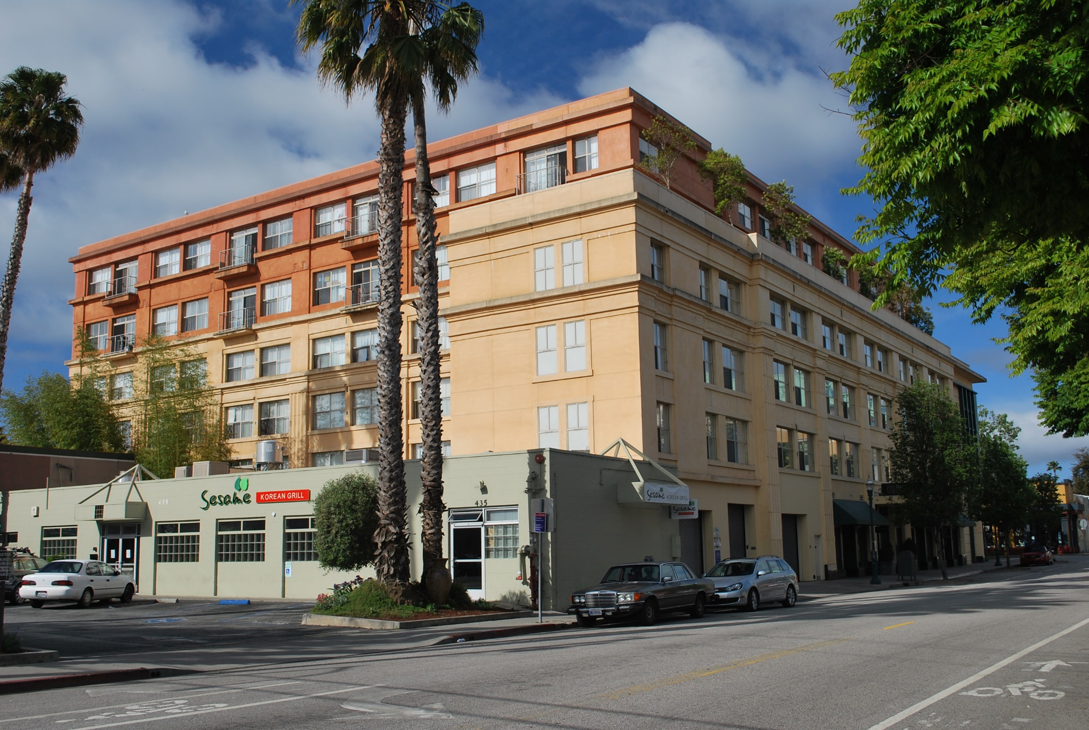
76.5’ – Top of Elevator Penthouse
66.5’ – Top of 6th Floor
50.0’ – Top of Parapet
1010 Pacific

Slide 5
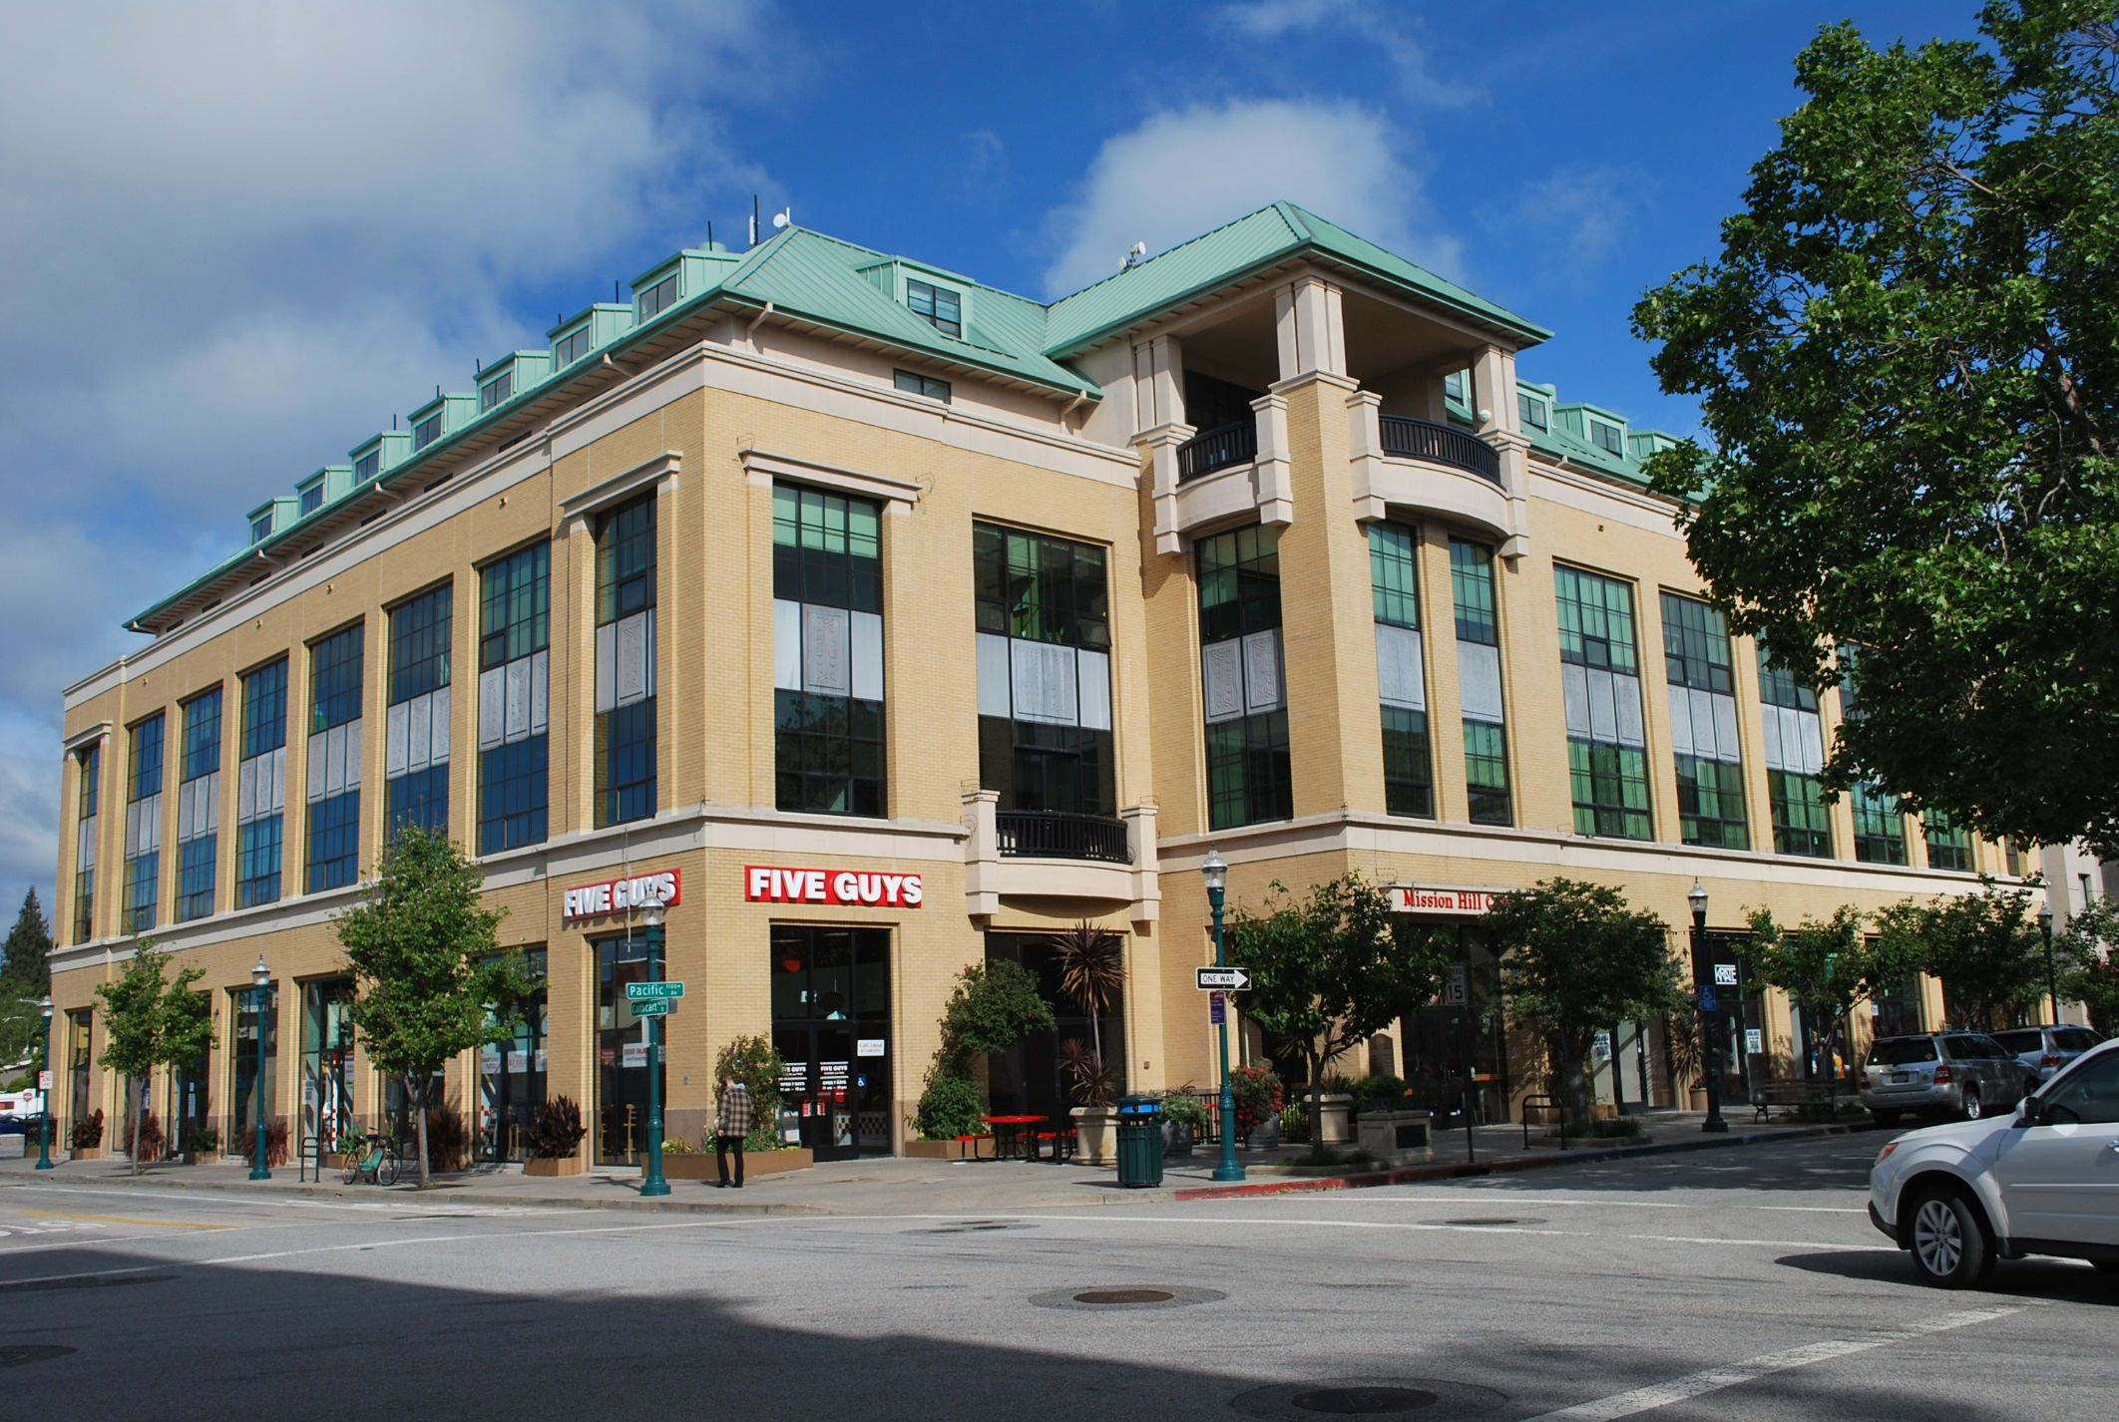
69.5’ Top of Roof
University Town Center, 1101 Pacific

Slide 6
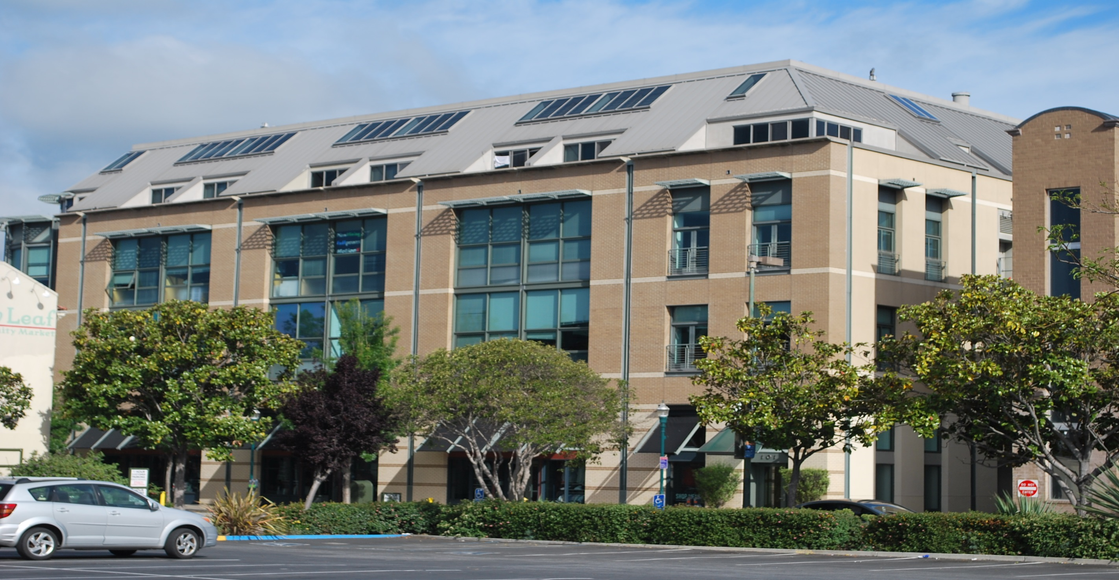
64.5’ – Building Height
Redtree Building, 1200 Pacific

Slide 7
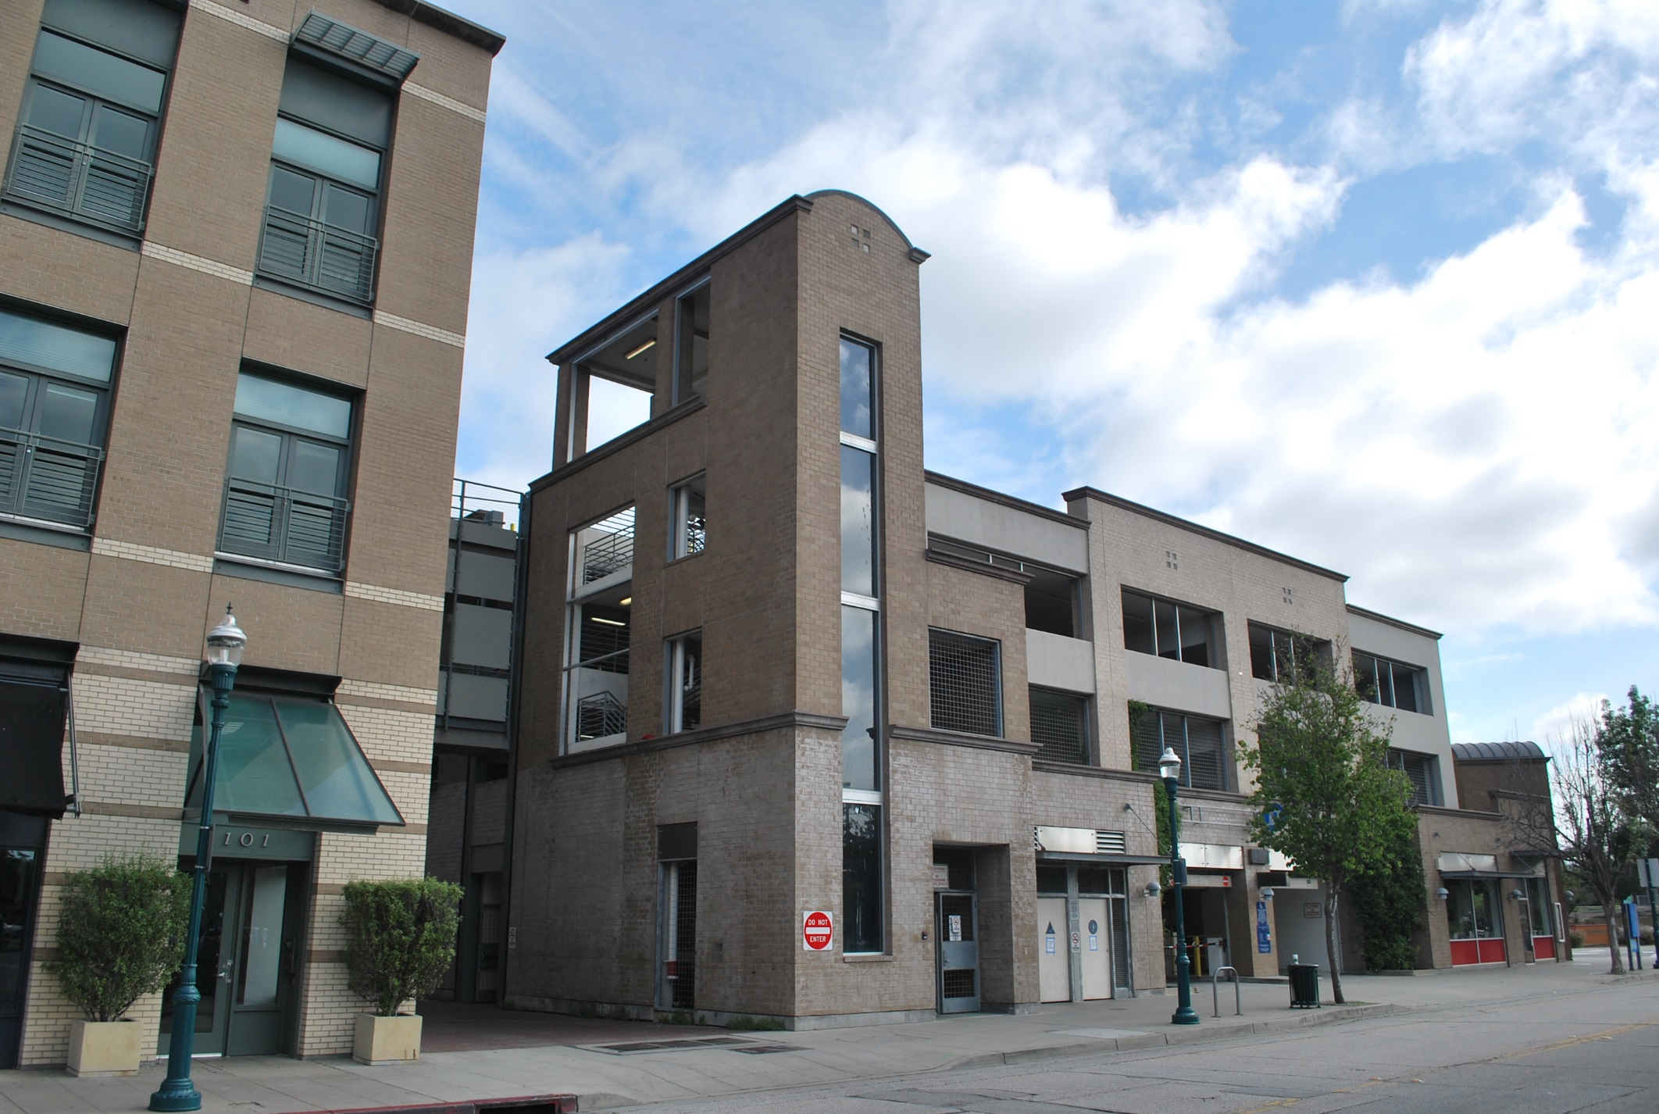
58.55’ – Top of Tower Element
Front St/Soquel Parking Garage

Slide 8
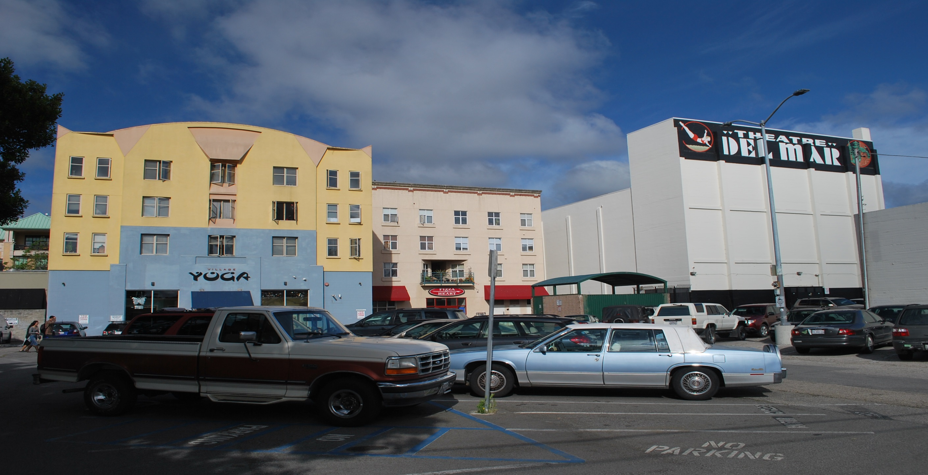

49.5’ – El Centro Building Height
64.5’ – Building Height
El Centro and Del Mar Buildings

Slide 9
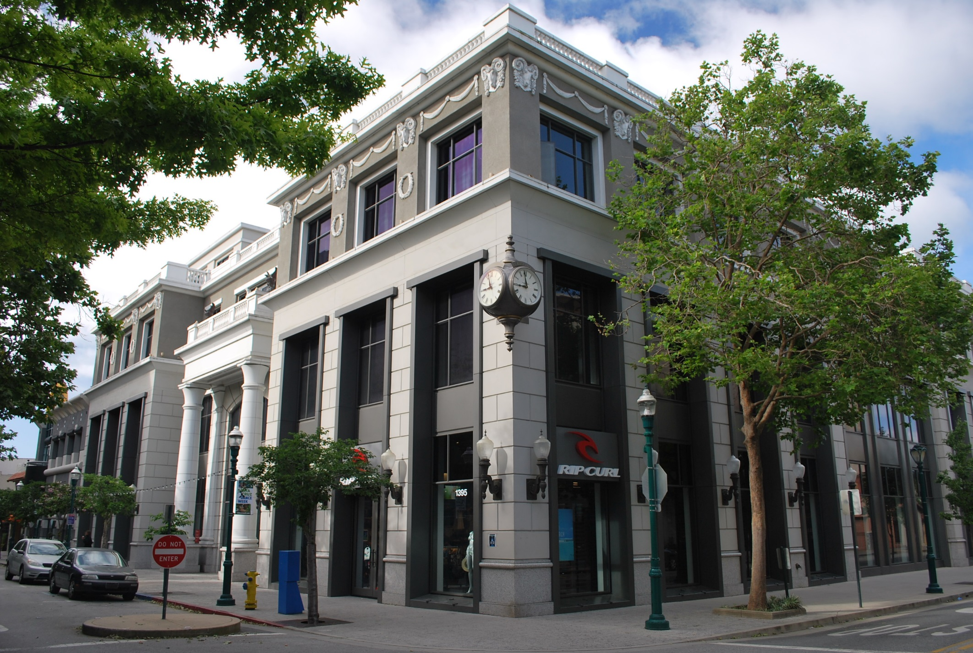
80’ – Top of Mech/Elev Tower
~50’ – Top of Stepback Parapet
Rittenhouse, 1375 Pacific

Slide 10
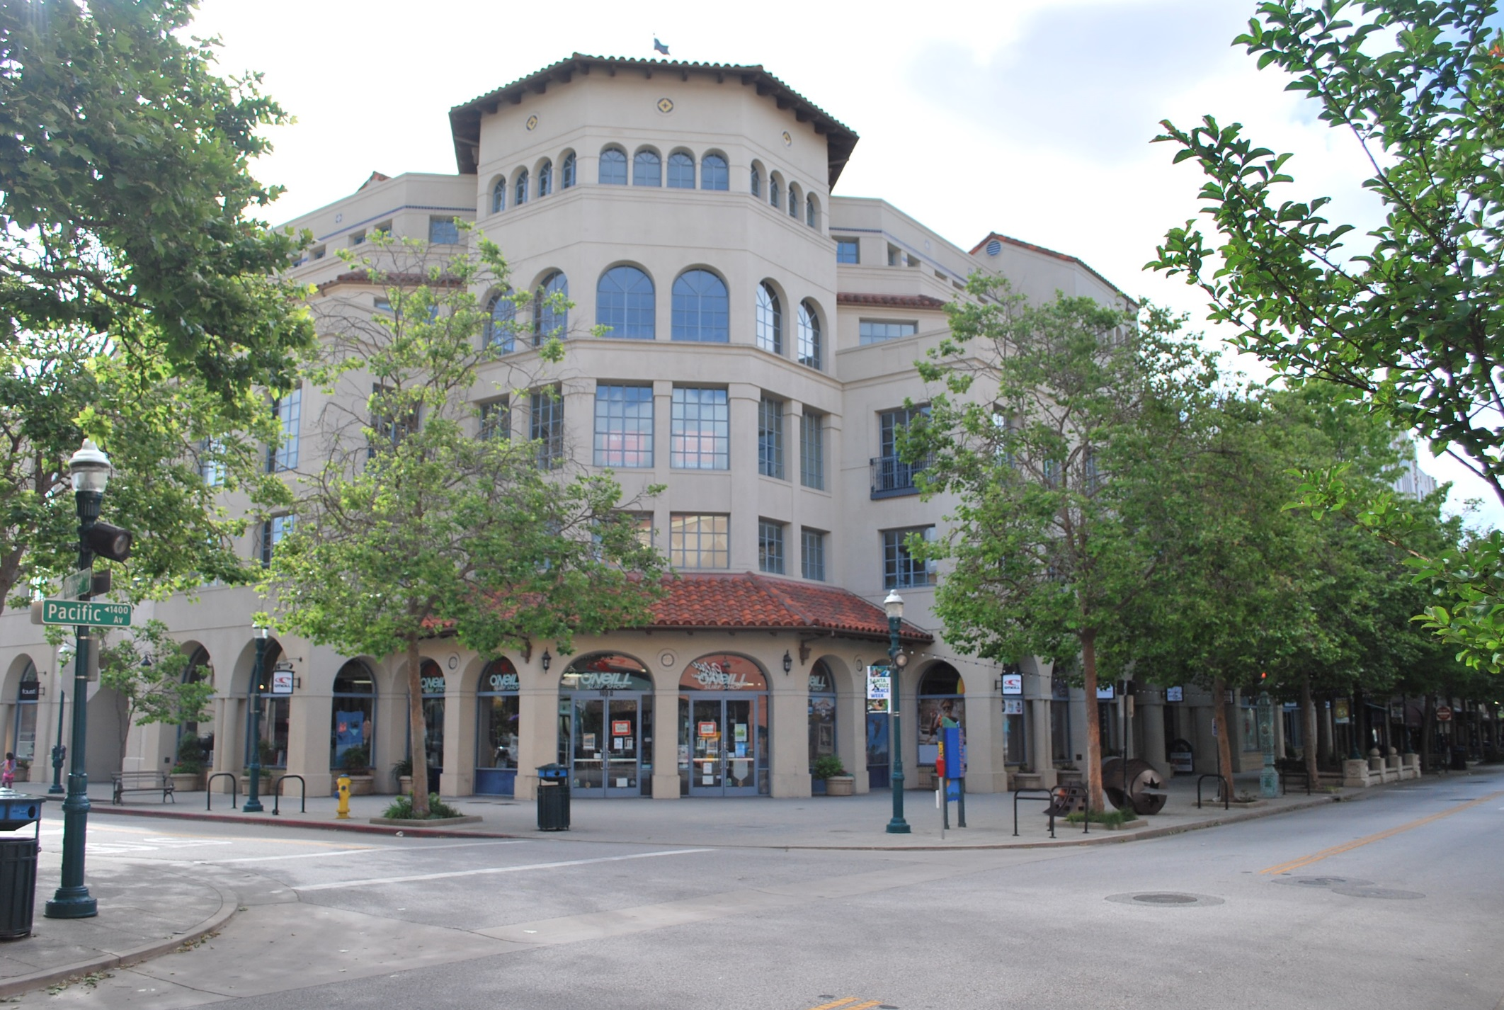
80’ – Top of Penthouse Roof
~50’ – Top of Stepback Parapet
Cooper House, 110 Cooper Street

Slide 11
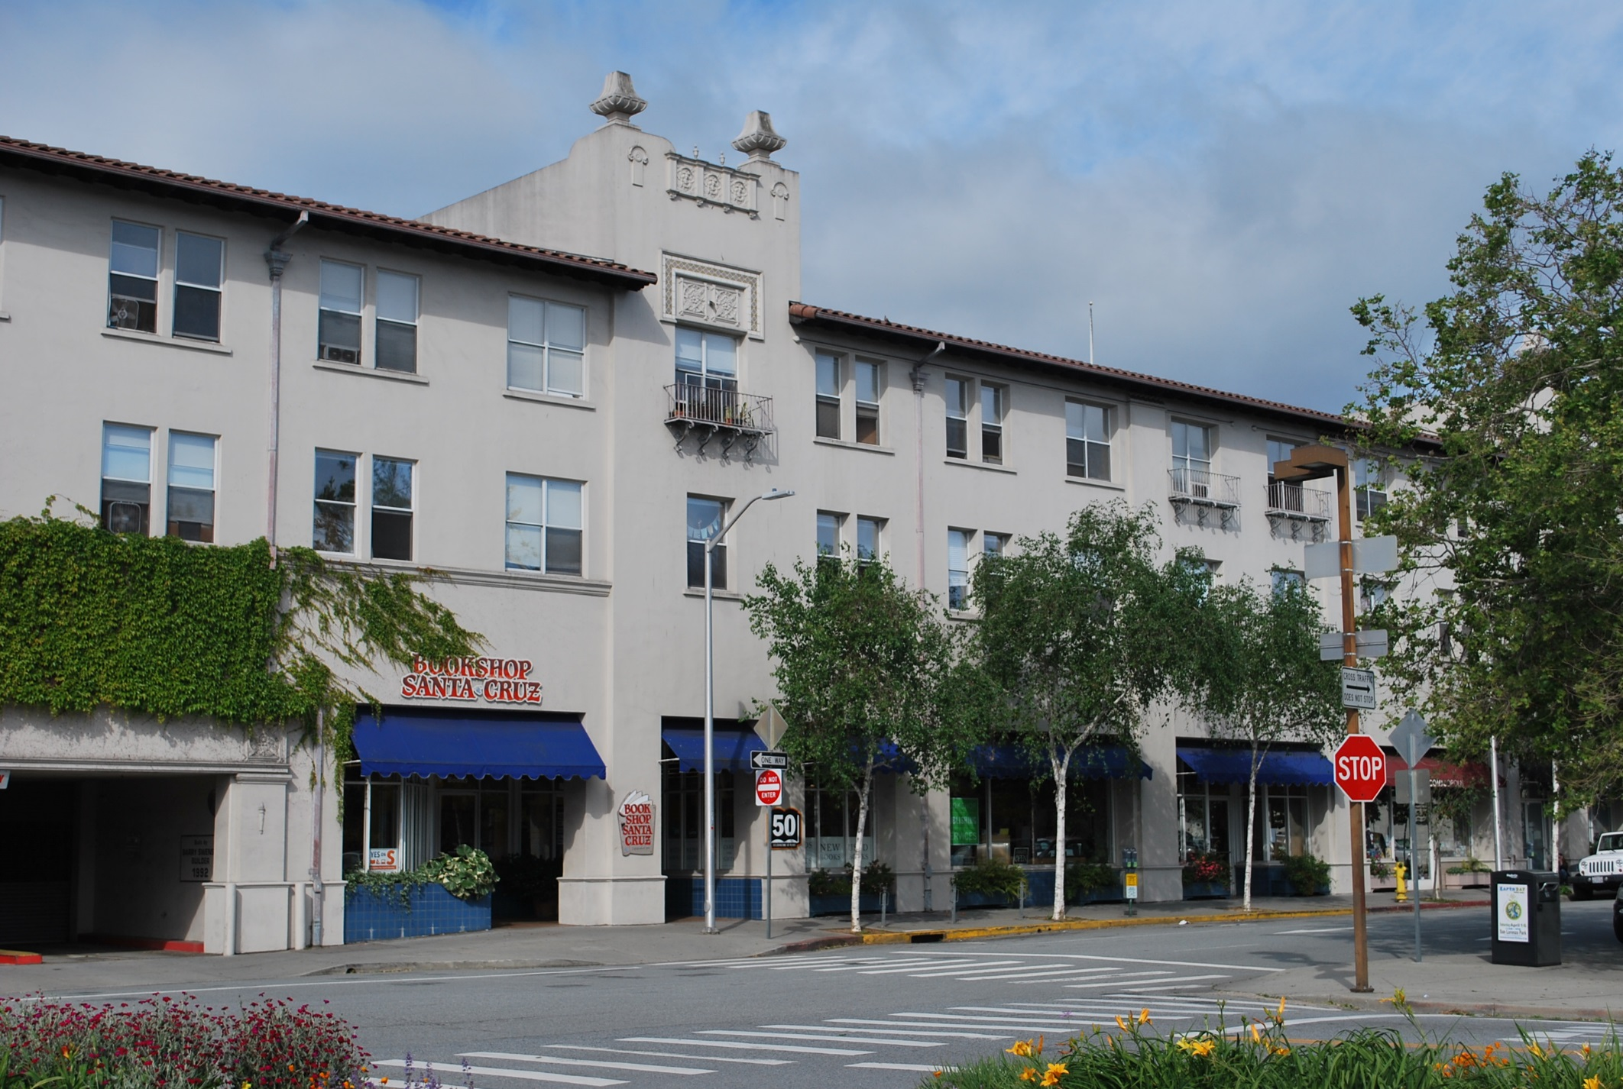
46 to 49’ – From Ground Level to Tower Element
St. George Hotel, 833 Front Street

Slide 12
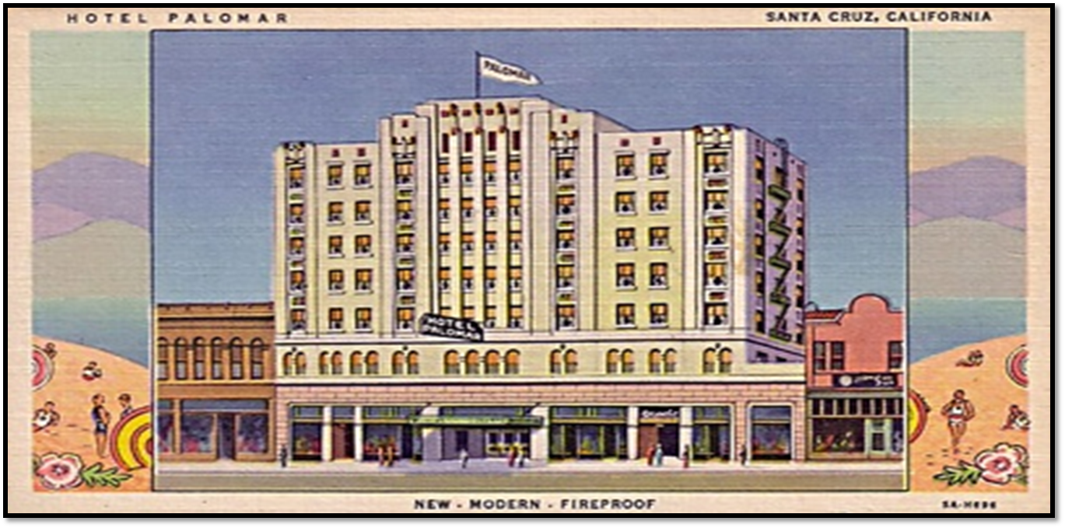
AND THE CORRECT ANSWER IS:
Hotel Palomar, 1344 Pacific

Slide 13
AND THE CORRECT ANSWER IS: 92’
Hotel Palomar, 1344 Pacific

Slide 14
Topics Raised at 4/28/2016 Planning Commission Meeting
  Parking
    The DRP does not specify parking standards
    City Council sets Downtown District requirements by Resolution
      Downtown Commission Recommendations (Planning Commission may also recommend)
    Off-site parking is allowed in District
  Affordable Housing Requirements
    Existing: 15% inclusionary units only apply to ‘for-sale’ units
    Proposed: Require 15% inclusionary units for rental units too, in exchange for exceeding the base heights in either the Pacific or Front areas
  Upper level development on Front Street
  Design Review Process

