Slide 1
CZU August Lightning Complex Fire City of Santa Cruz Watershed and Drinking Water Source Water Protection Issues
November 2020
Chris Berry, Santa Cruz Water Department –
Watershed Compliance Manager

Slide 2
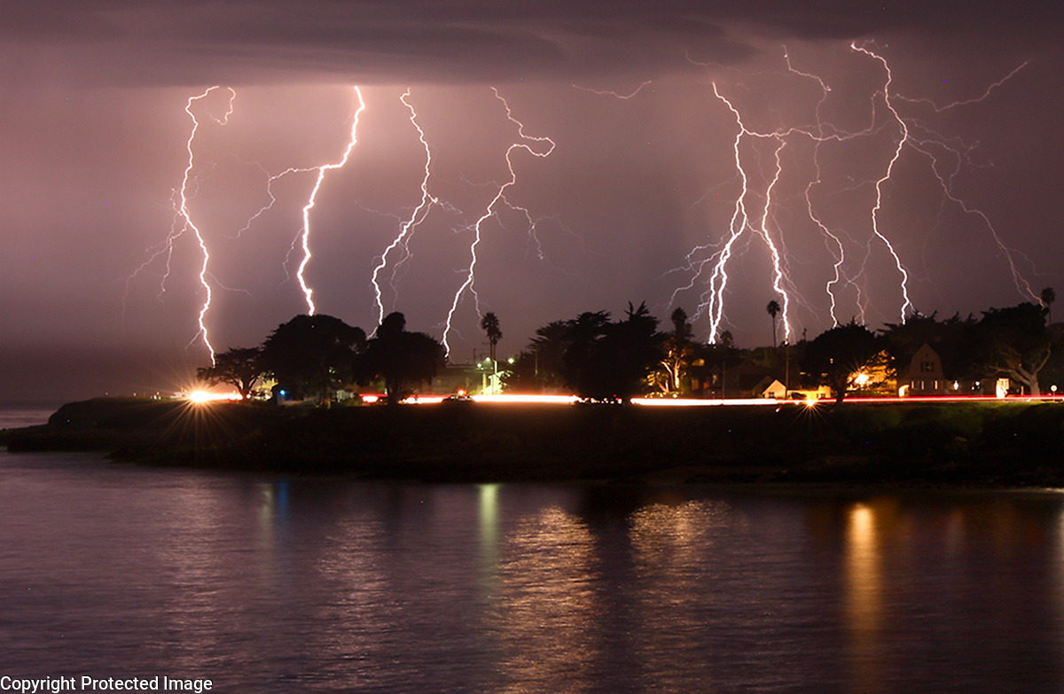
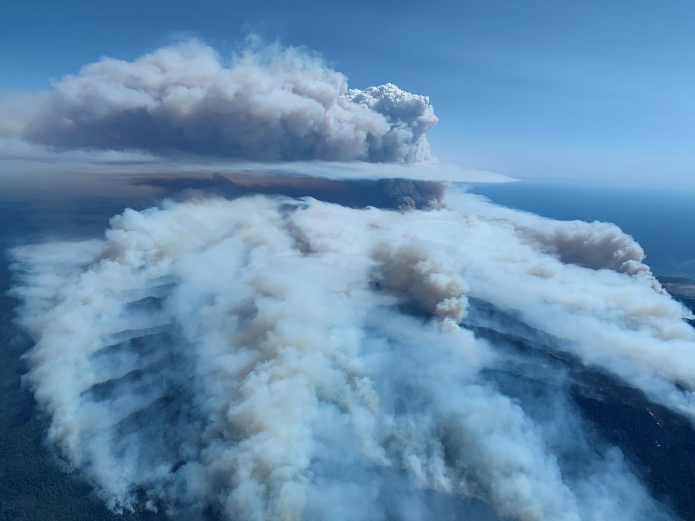
Outline
Outline
-Fire Background
-City of Santa Cruz Water System Background
-Effects of the Fire on City of Santa Cruz Drinking Water Source Watersheds
-Post-Fire Source Protection Efforts
-Other Post-Fire Response Concerns
-Links of Interest
Top: Lightning event in Santa Cruz. Photo: Shmuel Thaler. Bottom: CZU August Lightning Complex Fire. Photo: Cal Fire.
Notes:
Picture of Fire

Slide 3
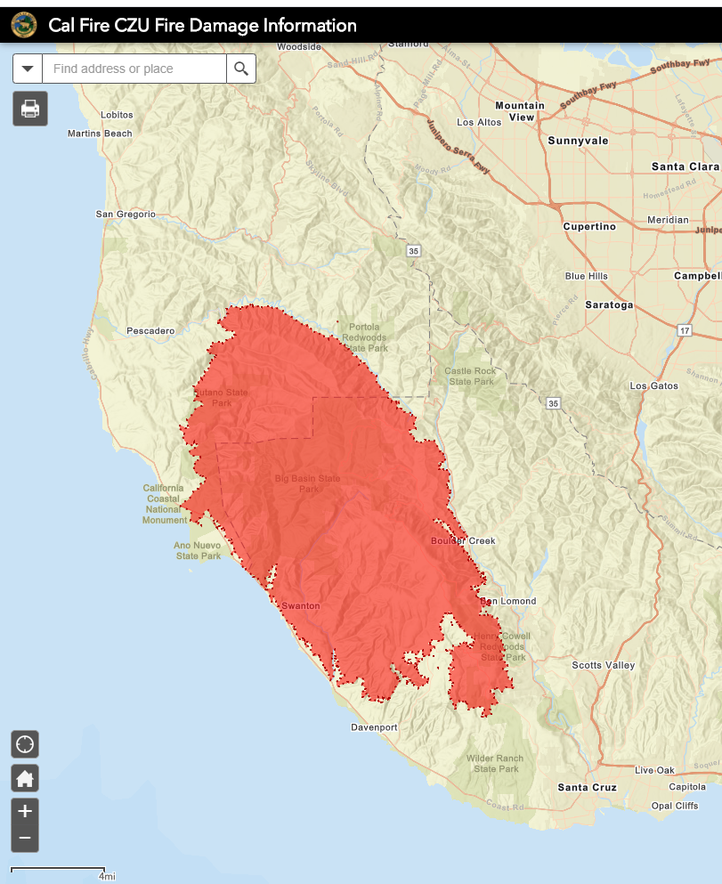
Fire Background
-86,509 acres
-Started August 16, 2020 by lightning
-Fully contained on September 22, 2020
-1,490 structures destroyed
-140 structures damaged
-Thousands of vehicles destroyed
-1 fatality
-Burned in all City of Santa Cruz drinking water source watersheds except Newell (Loch Lomond)
Source: https://www.arcgis.com/apps/webappviewer/index.html?id=5461c7f372e24ab68ca386e73d58e35a
Notes:
Insert map of fire

Slide 4
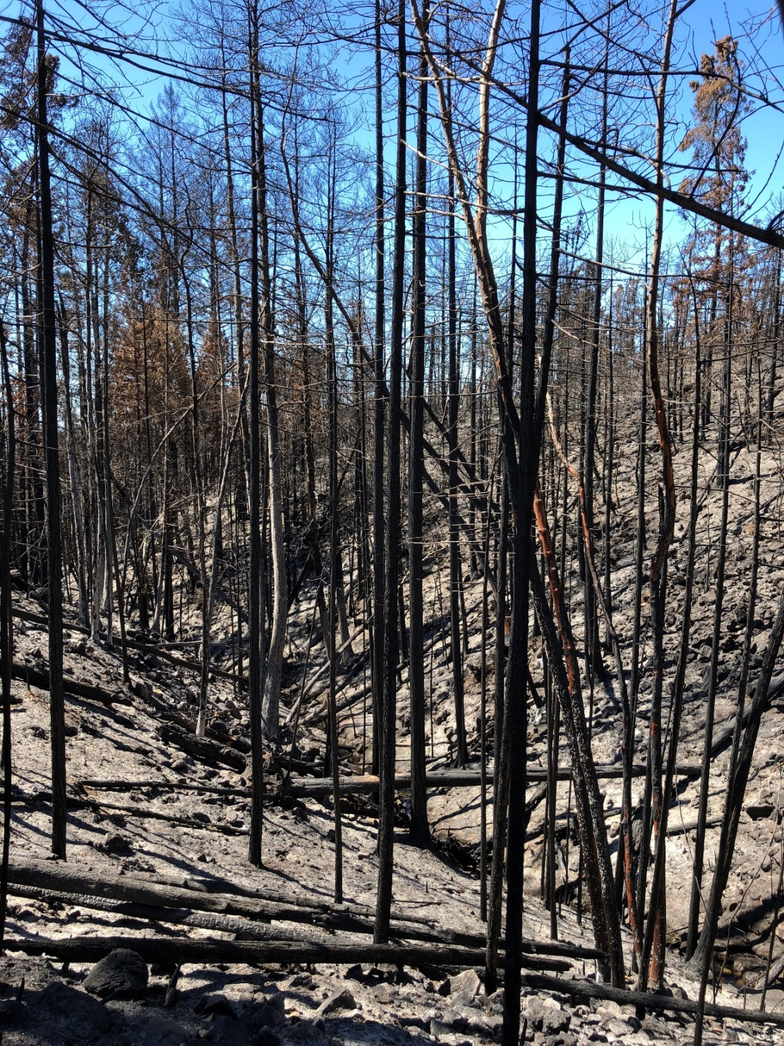
Fire Background (cont.)
-Burn intensity was highly variable
-Approximately 43 percent of the fire burned at moderate to high soil burn severity, the remaining 57 percent burned at low to very low
-The large proportion of moderate to high soil burn severity means the likelihood and magnitude of hazards are high for some areas downslope/
downstream of the fire
-Several coho recovery and drinking water source watersheds were involved in the fire (some severely burned)
High intensity burn area with great erosion potential upstream of City water intake. Photo: Chris Berry

Slide 5
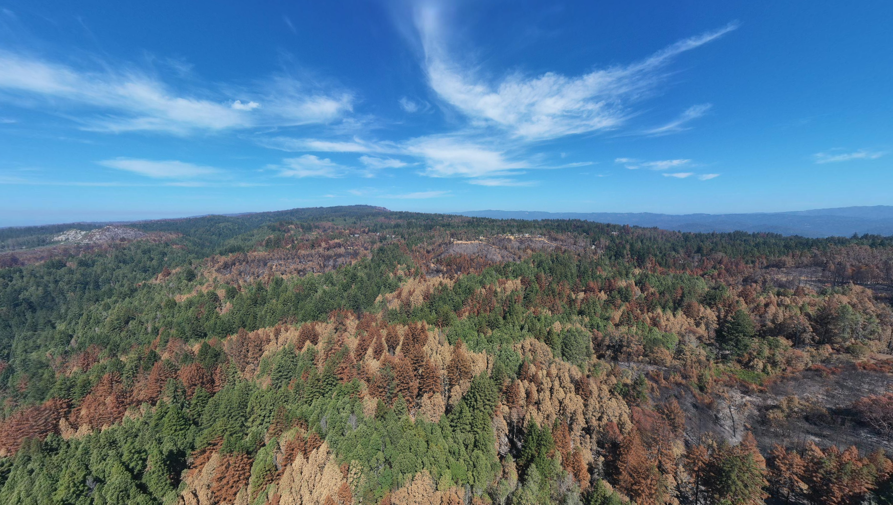
Mosaic of burn intensities in City North Coast watersheds. Photo: County of Santa Cruz

Slide 6
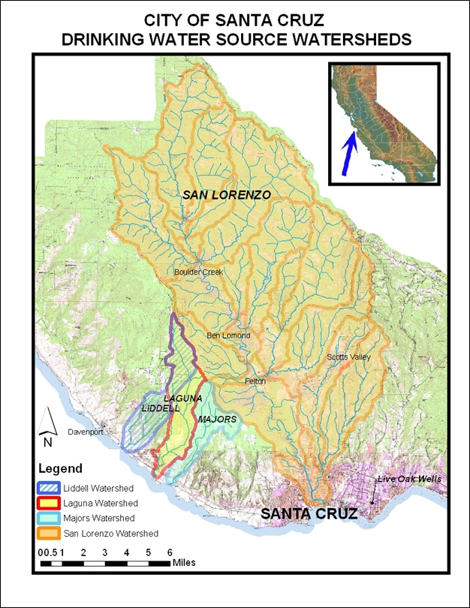
City of Santa Cruz Water System Background
-Serves 98,000 customers
-95% of supply from surface water sources
-Limited source flexibility
-Several source watersheds were impacted by fire
-Loch Lomond is critical to supply reliability and was (thankfully) not involved in the fire.
-Substantial environmental regulatory compliance constrains SCWD operations
Notes:
Insert City water system and watersheds map

Slide 7
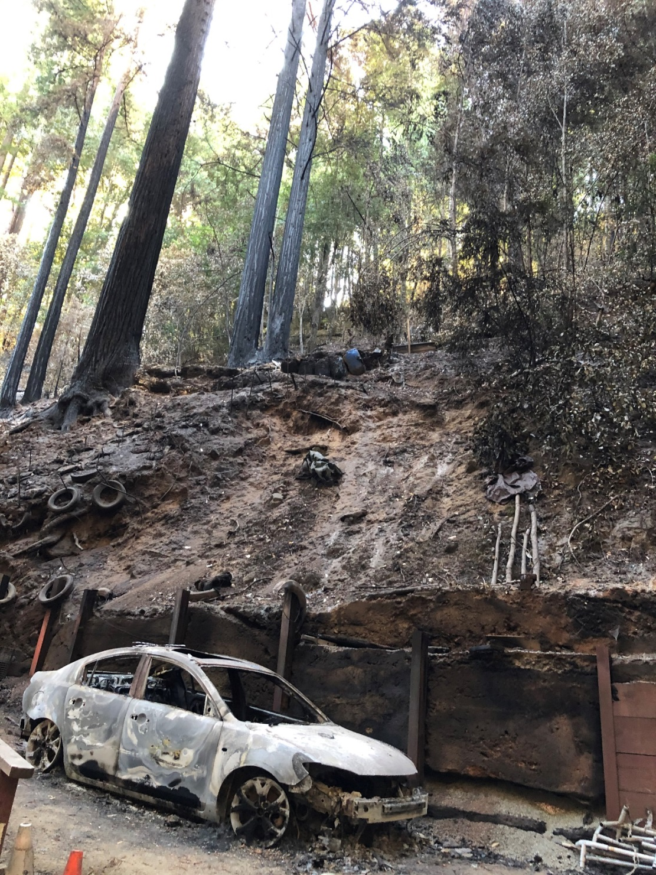
Effects of the Fire on Source Watersheds
-Increased risk for stream flashiness and flooding
-Increased sediment, nutrient, organic carbon and potentially toxic runoff, resulting in treatment challenges
-Increased debris flow that could impact infrastructure
- Changes to vegetation, including spread of invasive species like French broom, and a reduction in large fir presence, etc.
-Potential for negative impacts to instream and upslope habitat, as well as benefits
Burned residential property presenting multiple threats to downstream water quality and instream habitat. Photo: Chris Berry
Notes:
Map of values burned and watershed boundary

Slide 8
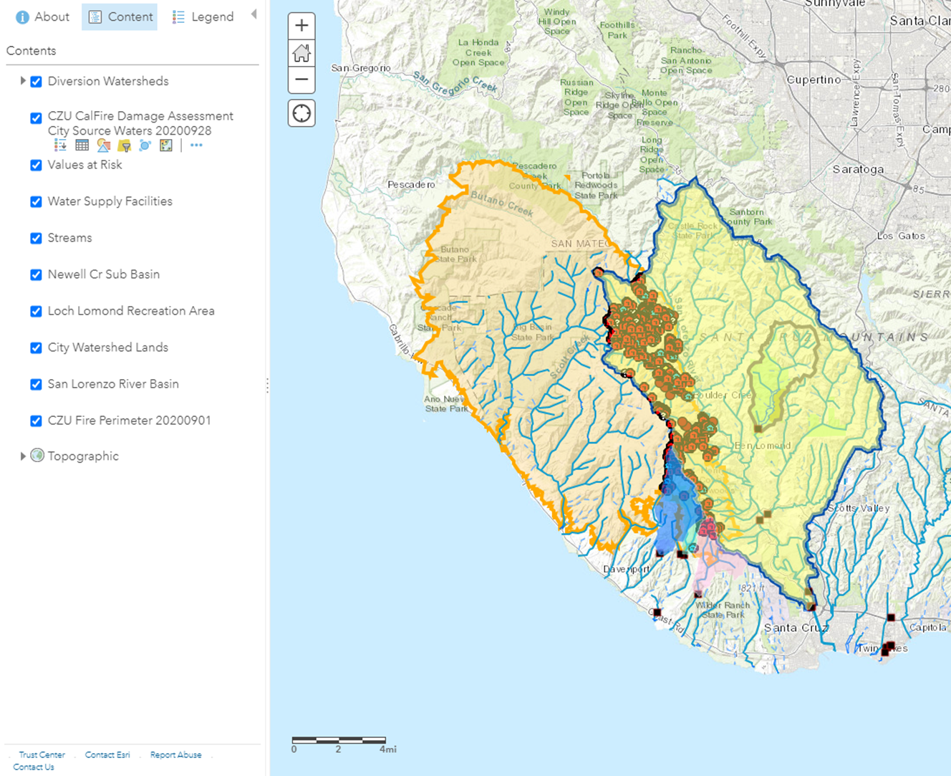
Values at risk in City of Santa Cruz Drinking Water Supply Watersheds. Map: Zeke Bean
Notes:
Sandhills image

Slide 9
Debris flow hazard probability. Note data may be biased by methodology and not show localized hazards in the upper San Lorenzo basin accurately.
Source: https://landslides.usgs.gov/hazards/postfire_debrisflow/detail.php?objectid=299

Slide 10
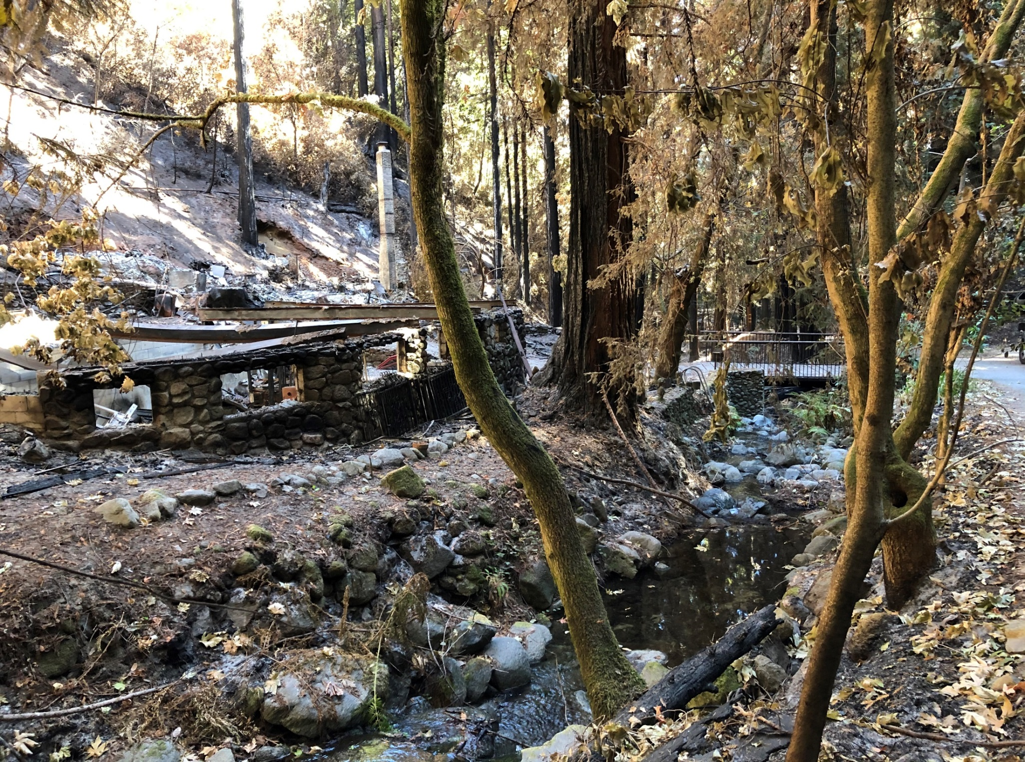
Destroyed streamside structures present multiple threats to downstream water quality and instream habitat. Photo: Chris Berry

Slide 11
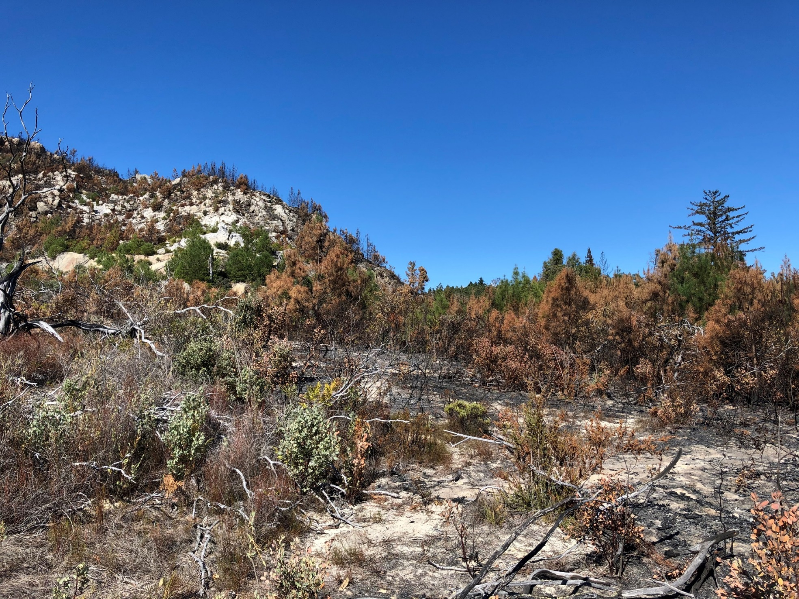
Beneficial burn upstream of City water intake on Mount Hermon June beetle mitigation site. Photo: Chris Berry
Notes:
Redwood forest image

Slide 12
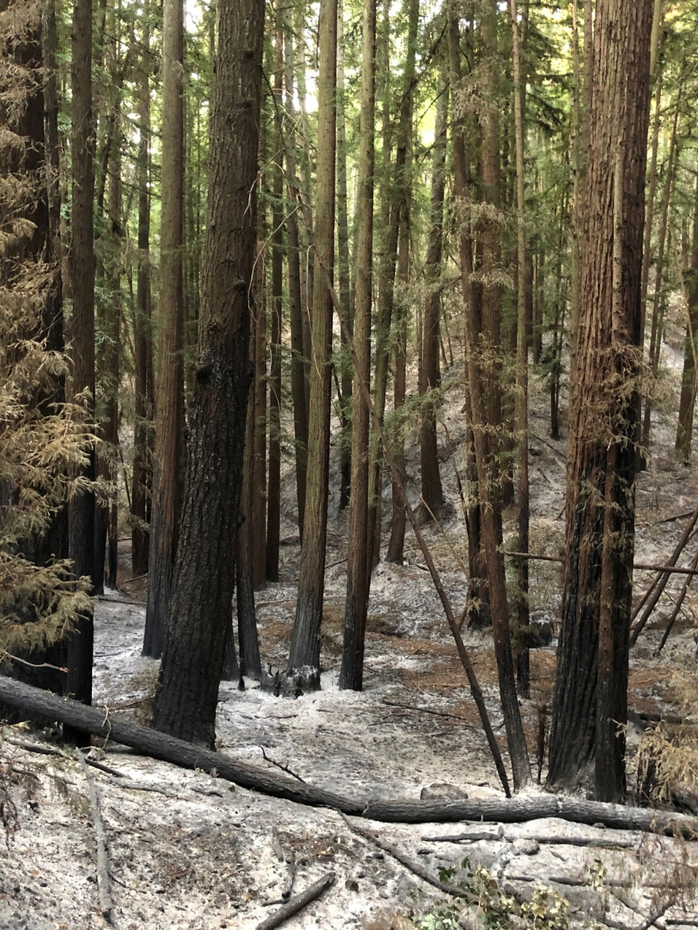
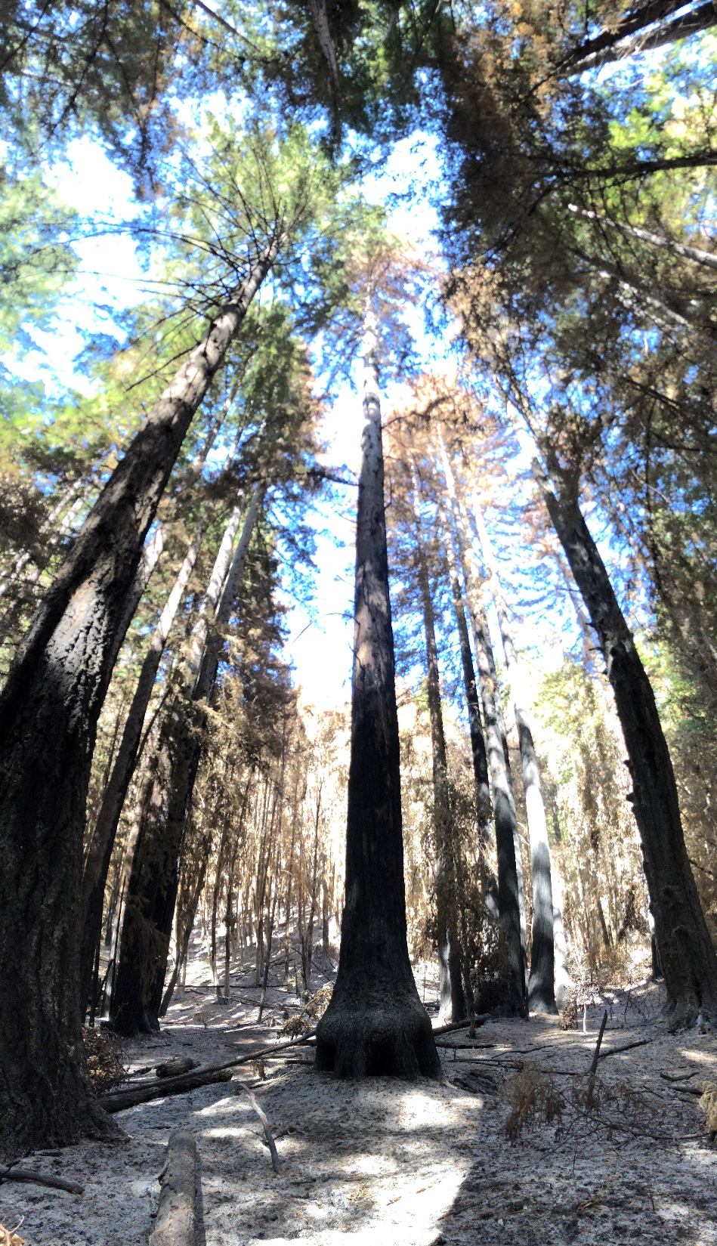
Beneficial burn areas in potential marbled murrelet habitat. Photos: Chris Berry

Slide 13
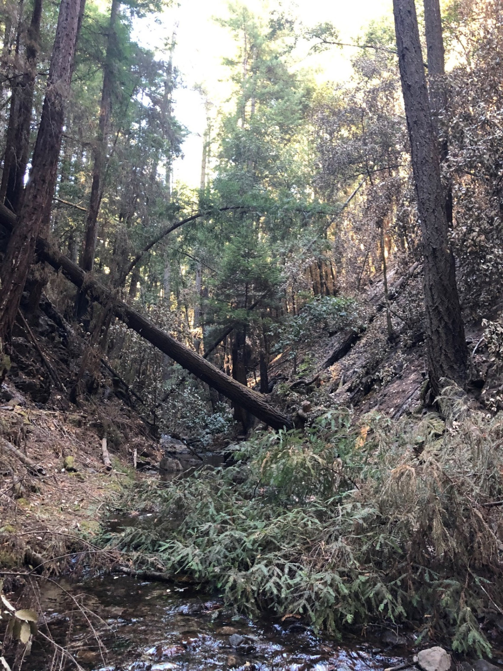
Beneficial fire – related “large woody debris” recruitment to stream channel. Photo: Chris Berry
Notes:
Instream wood

Slide 14
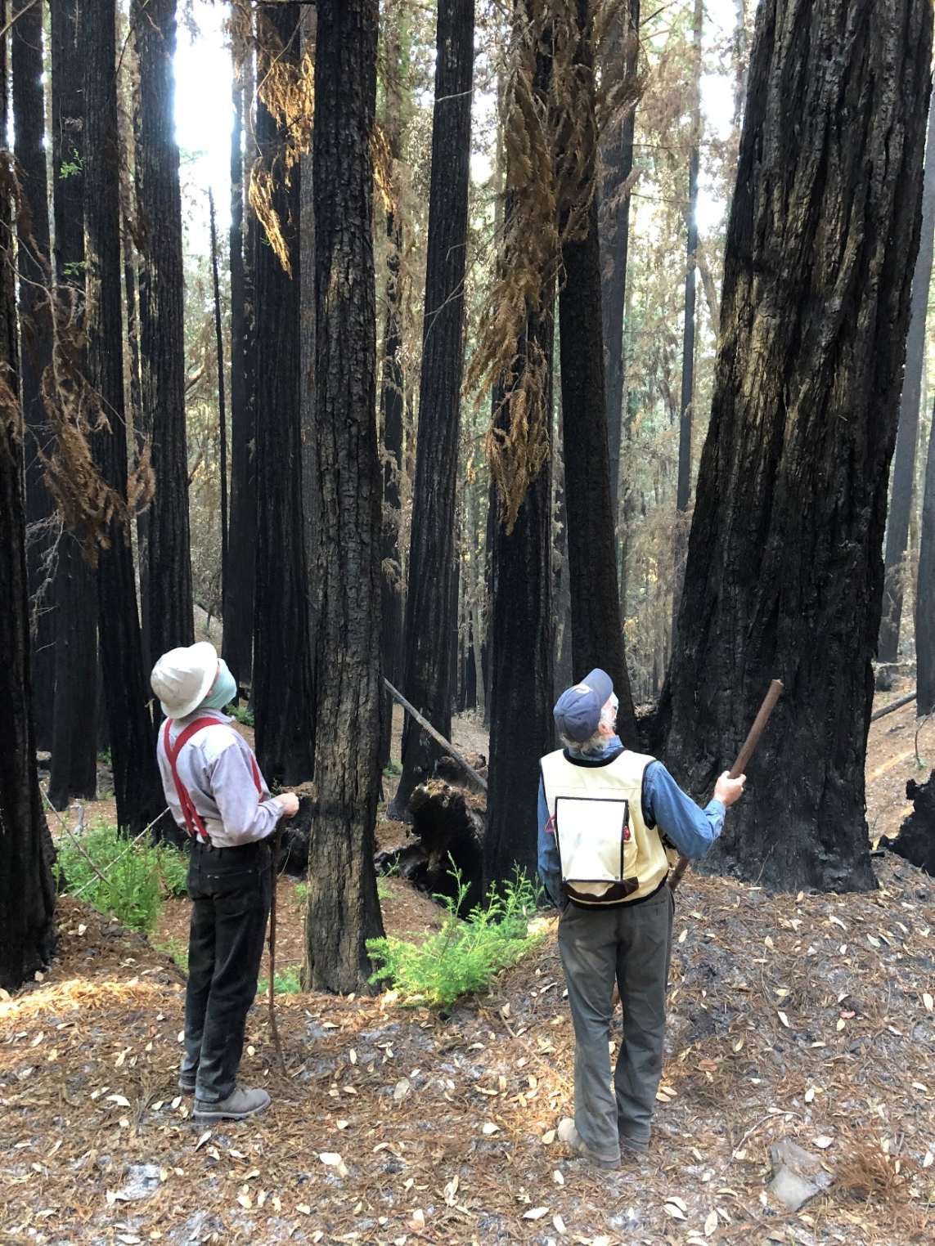
Post Fire Watershed and Source Protection Work
Prioritize “Phase 2” cleanup for City water source watersheds
(Liddell karst recharge zone and streamside areas in the San Lorenzo), including:
-Support private landowner technical assistance response led by Resource Conservation District (RCD)
-Evaluate and improve forest resiliency on City watershed lands
-Remove hazardous trees
-Increase and broaden monitoring
(water quality, sediment, biotic)
- Adapt operations (source selection, pipeline and intake maintenance, etc.)
-Let Nature take its course!
Foresters evaluating burned timber on City watershed lands. Photo: Chris Berry
Notes:
Image: rwqcb visit, fuel break

Slide 15
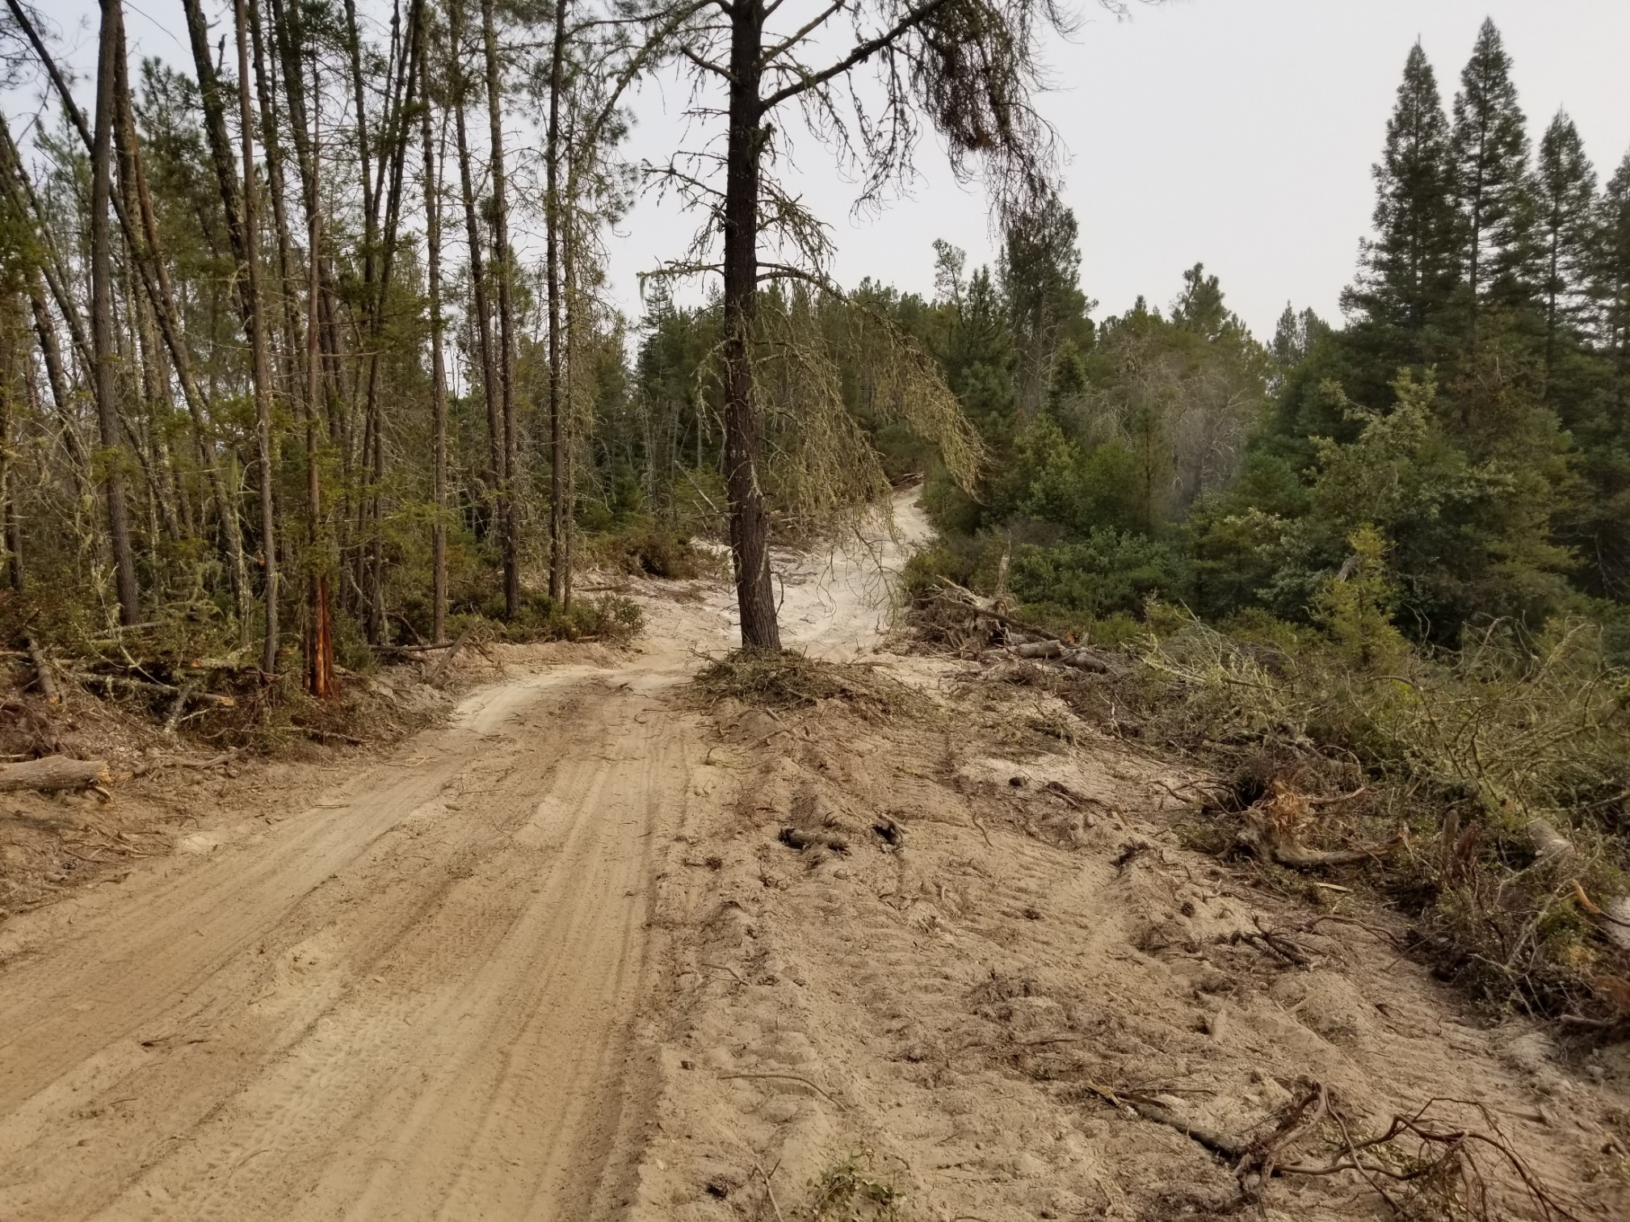
Improved fuel break on City watershed lands. Photo: Gar Eidam

Slide 16
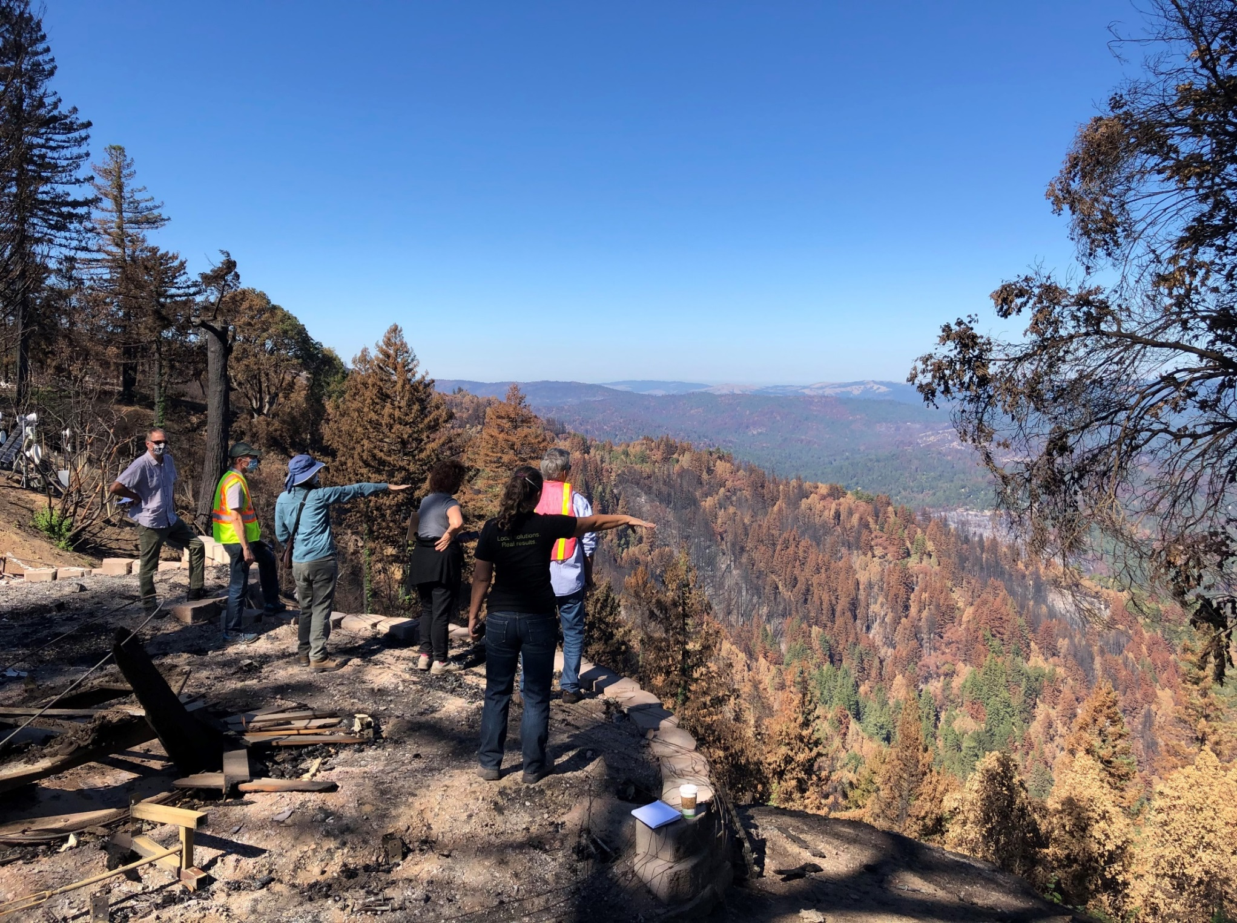
Multi-agency post-fire response recon. Photo: Chris Berry

Slide 17
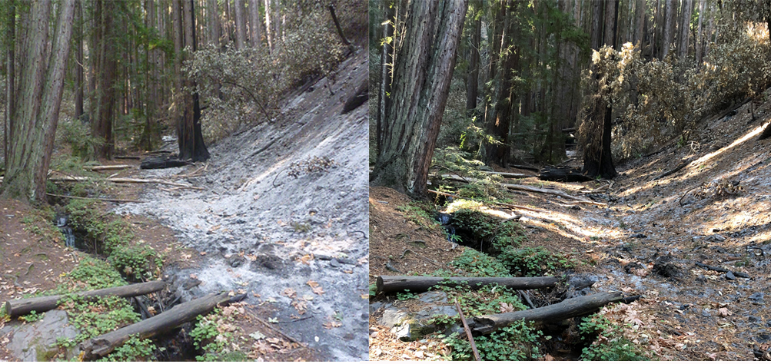
Nature taking its course. Note duff covering ash and providing erosion control just a couple weeks after the fire was contained. Photos: Chris Berry
Notes:
Duff comparison

Slide 18
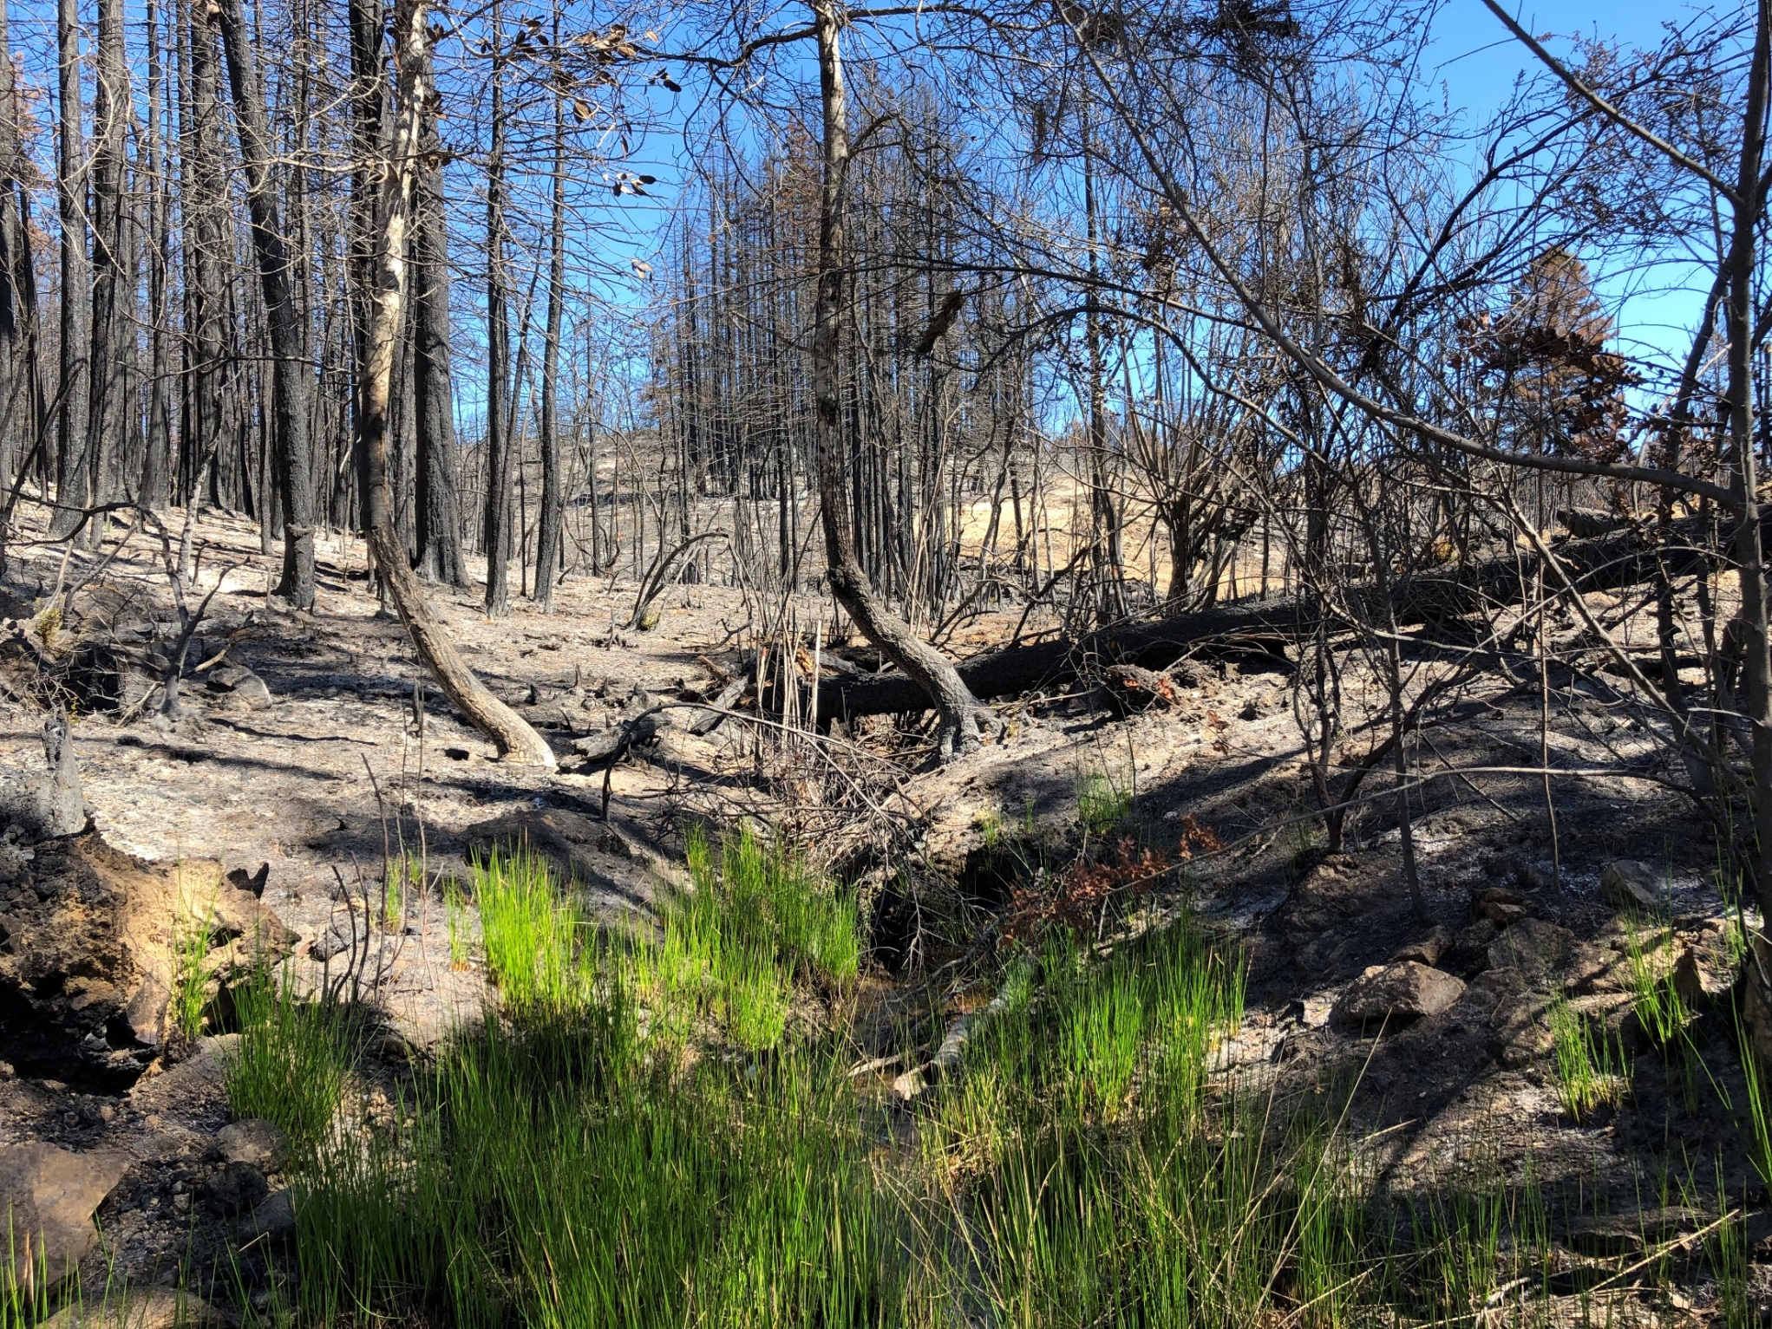
Significant resprouting is occurring already, even in high intensity burn areas. Photo: Chris Berry
Notes:
resprouting

Slide 19
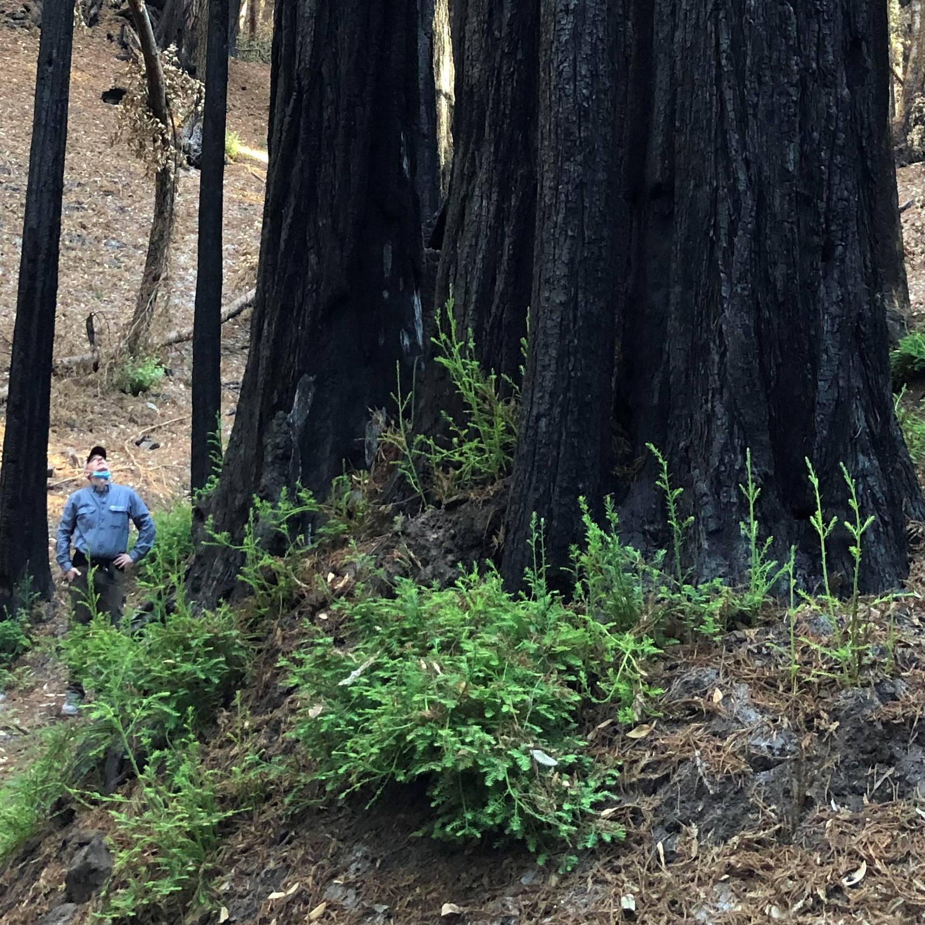
Significant resprouting is occurring already, even in high intensity burn areas. Photo: Chris Berry

Slide 20
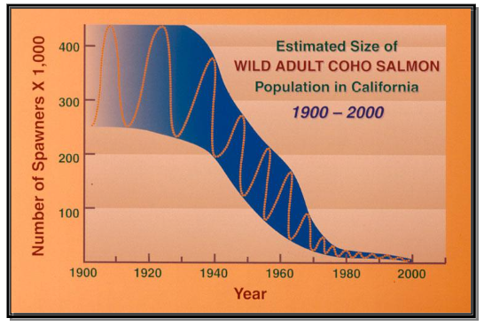
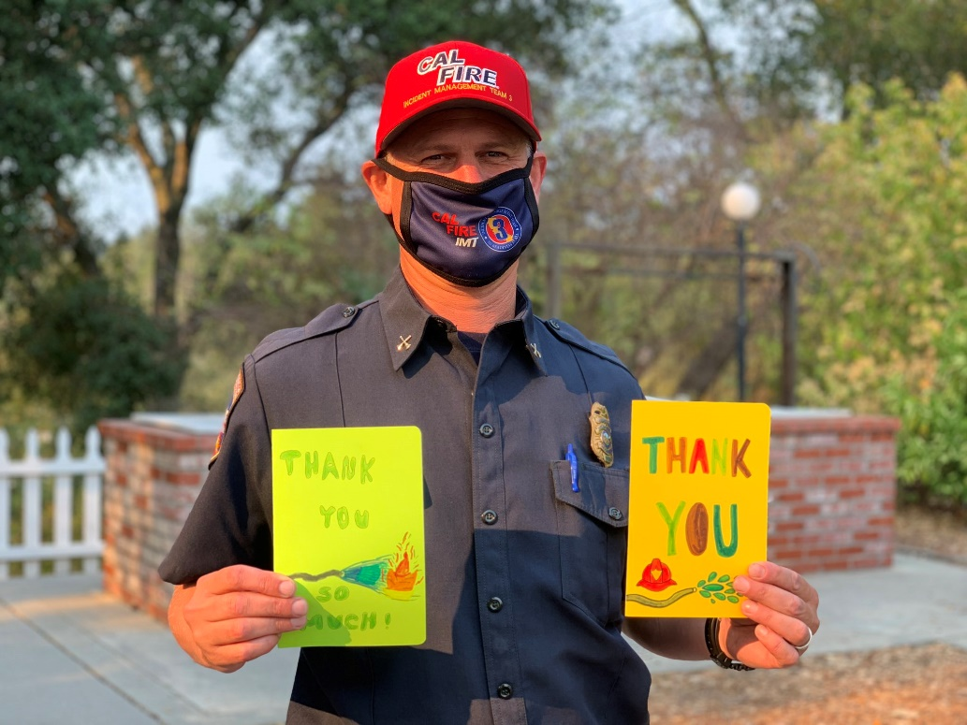
Other Post-Fire Response Concerns:
-Potential significant impacts on already-vulnerable special-status species
Negative impacts of fire on coho salmon can create regulatory challenges for water operations
-Watershed management response to fire is a long-term, multi-disciplinary, multi-agency process
The response to fire requires an ongoing commitment - especially for watersheds like the San Lorenzo that have a proliferation of development and related infrastructure, as well as a need to support many diverse “beneficial uses” such as municipal drinking water, cold freshwater habitat, water recreation, etc.
-
Top: Coho population status. Photo: NMFS, Bottom: Cal Fire Battalion Chief Mark Brunton: Photo: Cal Fire
Notes:
Resprout pic

Slide 21
Links of Interest:
-Watershed Emergency Response Team Report
https://drive.google.com/file/d/1UqZUgCin55BEQ_QgXVRr44QIaUpQt1w2/view?usp=sharing
-Santa Cruz County Drone Surveys
https://www.arcgis.com/apps/webappviewer/index.html?id=b657b3e887ef486aafbec9fff986fc91&extent=-13625344.1096%2C4436300.9559%2C-13565723.2276%2C4471691.3%2C102100
-United States Geologic Survey Debris Flow Potential Map
https://landslides.usgs.gov/hazards/postfire_debrisflow/detail.php?objectid=299
-United States Geologic Survey Hydrologic and Erosion Responses of Burned Watersheds
https://www.usgs.gov/mission-areas/water-resources/science/hydrologic-and-erosion-responses-burned-watersheds?qt-science_center_objects=0#qt-science_center_objects
-Resource Conservation District Post - Fire Response Resources
http://www.rcdsantacruz.org/post-fire
Natural Resources Conservation Service Post – Fire “Dos” and “Don’ts”
https://drive.google.com/file/d/1wxUMkR7_XoigVPK9WqeVprF-X8V3CywG/view?usp=sharing

Slide 22
Links of Interest (cont.)
-Community Wildfire Protection Plan for Santa Cruz and San Mateo Counties:
https://drive.google.com/file/d/1zXMV-VS9teMQS0vC6QKei1ZHNZIUSXar/view?usp=sharing
-Cal Fire Unit Strategic Fire Plan San Mateo-Santa Cruz
http://www.santacruzcountyfire.com/fire_prevention/2011_czu_fireplan.pdf
-Santa Cruz County Post – Fire Response Resources
https://www.co.santa-cruz.ca.us/FireRecovery.aspx
-Fire Safe Santa Cruz County
https://www.firesafesantacruz.org/

Slide 23
Contact: cberry”@”cityofsantacruz.com

