Slide 1


City of Santa Cruz
Water Cost of Service and Rate Study
City Council Meeting
September 21, 2021

Slide 2
Process Overview
Rate Setting Framework
Proposed Rate Structure
Financial Plan Review
Proposed Water Rates
Proposed Drought Rates
Next Steps
Agenda

Slide 3
Process Overview

Slide 4
Schedule
Key Event | Date
Request for Qualifications Issued | October 3, 2019
Contract Awarded | January 14, 2020
Kick-Off Meeting | February 10, 2020
Water Commission Meetings (9 meetings) | 2020: May 4, June 1, September 14, November 2 2021: February 16, March 1, May 3, July 12, August 23
Customer Panels (8 panels) | Commercial: April 7, April 21, May 5 Irrigation: April 7, April 21, May 5 Residential: June 8, June 22
City Council Meetings (2 meetings) | April 6, 2021 September 21, 2021 (today’s meeting)
Public Hearing | November 23, 2021

Slide 5
Study Objectives
Conduct an updated cost-of-service analysis​
Design equitable and defensible water rates
Develop drought rates by stages​
Develop System Development Charges​
Develop and implement a public outreach strategy
Develop an administrative record that justifies the logic / rationality on the proposed rates​
Implement five years of water rates

Slide 6
Steps Conducted
Policy objective workshop
Inside/outside surcharge
Wholesale water transfer charge
Elevation surcharge
Rate structure options
Infrastructure reinvestment fee options
Detailed asset data analysis
System development charge
North Coast Agriculture rate options
Private fire capacity analysis
Drought rates
Customer panels
Rate structure preferences by customer class

Slide 7
Rate Study Process
Financial Plan Review
Evaluation of CIP and financing options
Cash flow analysis for financial sufficiency
Final Rate Adoption
Report
Prop 218 Notice
Public Hearing
Cost of Service & Rate Design
Cost allocations
Rate design
Rate calculations
Customer impact analyses
Rate Setting Framework
Financial goals and policies
Pricing objectives

Slide 8
Rate Setting
Framework

Slide 9
Determining an Appropriate Rate Structure
Determine goals and objectives of the agency
What do we want the rates to achieve?
Business case
Do the benefits outweigh the costs?
Customer impacts
To what degree are customer bills impacted?

Slide 10
Policy Objectives
Efficiency/
Conservation
Funding Mechanism
Rate Stability & Affordability
Equity and Allocation Methodologies
Administration
Promotes efficient water use
Promotes conservation
Provides tool for drought management action plan
Enhances revenue stability
Enhances revenue sufficiency
Maintains transparency regarding CIP needs
Meets the terms and conditions of the Long Term Financial Plan
Facilitates equitable access to water
Supports affordability for essential use
Promotes rate stability
Minimize overall customer impacts
Allocates capital costs equitably
Accounts for individual needs
Is based on best practices and industry standard methodologies
Eases administration
Eases implementation
Is simple to communicate
10

Slide 11
Results of Policy Objective Exercise
The policy objectives exercise was conducted with the City Council and Water Commission
Highest priority themes identified:
To ensure water for essential use is affordable and accessible
To provide sufficient and stable revenues to meet operating, capital and customer service level needs
To maintain transparency and equity for capital and water reliability needs
Given limited resources, staff is concerned with administrative ease

Slide 12
Proposed
Rate Structure

Slide 13
Current Rate Structure
Fixed Components
Variable Components
Ready-to-Serve (RTS) Charge
Based on meter size
Fire RTS Charge
Flat charge per month
Consumption Charge / Infrastructure Reinvestment Fee (IRF)
Residential: 4 tiers
Commercial, North Coast, UCSC: uniform
Irrigation: 3 tiers based on water budget
Elevation Surcharge
Rate Stabilization Fee
An Outside City surcharge of 14.5% is applied to all components, except for the Rate Stabilization Fee

Slide 14
Proposed Changes to Rate Structure
Eliminate Inside/Outside City surcharge
Based on refined analysis, the cost difference between Inside and Outside City customers is marginal
Surcharge is eliminated to simplify rate structure
Residential consumption charge/IRF tiers
Based on updated usage characteristics, Residential is proposed to move from four tiers to three tiers
Elevation surcharge
Proposed surcharge is based on three lift zones instead of one zone
Fire RTS charge
Allocating costs appropriately based on fire line capacity

Slide 15
IRF Alternatives
IRF currently collects $9 million (23% of costs)
IRF alternatives explored:
Tiered commodity (current methodology)
Uniform commodity
RTS charge based on meter size (fixed)
Property roll based on meter size (fixed)
Based on July 12 meeting, Water Commission provided direction to move forward with the tiered commodity methodology to assess IRF
Notes:
In a prior Water Commission meeting, we presented four options to assess the IRF to recover capital/infrastructure related costs. Based on discussions with the Water Commission and with Santa Cruz staff in May and June, and feedback from the customer panels, future water rates were developed for two options and presented at the July 12, 2021 Water Commission meeting: the tiered commodity option (based on the current methodology, but with updated COS allocations and residential rate structure) and the adding IRF revenue requirements to the readiness-to-serve charge based on meter sizes.

Slide 16
North Coast Agriculture Rate Options
Compared to all other Santa Cruz customers, North Coast Ag currently has the same level of service (water reliability) but does not require treatment
The two reliability options include:
Maintain reliability – keep the current level of service, subject to curtailment when all other customers are curtailed
Decreased reliability – water service will be “seasonally interruptible” based on water supply conditions in Santa Cruz
Notes:
Please see the more detailed discussion on North Coast Ag rate options in the Draft Long Range Financial Plan

Slide 17
Four Major Components of Revenue Requirement
RTS charge (fixed operating)
Customer service and billing: cost per account
Meter service: cost of replacing a meter
Consumption charge (variable operating)
Base: cost per unit of water
Peaking: based on peaking analysis
Supply: cost per unit of water
Conservation: targeted to upper tiers
IRF (variable capital)
Rate Stabilization Fee (variable)
No recommended changes

Slide 18
Financial Plan
Review

Slide 19
Financial Plan
IRF collects cash funded capital projects and debt service
O&M portion collects the remaining less Rate Stabilization Fee (RSF)
Revenue adjustments smoothed out for FY 2024 through FY 2027
Financial Plan | COS FY 2021 | Proposed FY 2023 | Proposed FY 2024 | Proposed FY 2025 | Proposed FY 2026 | Proposed FY 2027
O&M ($M) | $30.2 | $32.7 | $34.1 | $36.0 | $38.0 | $40.2
IRF ($M) | $9.1 | $9.3 | $14.5 | $21.4 | $21.5 | $25.0
Revenue Needed ($M) | $39.3 | $42.0 | $48.6 | $57.5 | $59.5 | $65.2
Revenue Adjustments |  | 6.9% | 16.2% | 16.2% | 6.9% | 6.9%
Notes:
The revenue requirement is broken into two portions: IRF and O&M. The total revenue requirement is the amount of rate revenue to be collected from the City's water customers and is based on the financial analysis provided by City staff using the PFM model. The total adjustment percentage is applied to the COS rates for FY 2023 through FY 2027. Although the revenue adjustments vary year to year, the average annual adjustment is approximately 10.8%.
COS Revenues ($39.3M) are the rates in FY 2021 multiplied by the FY 2019 consumption. FY 2019 consumption was before any COVID impacts.

Slide 20
Proposed
Water Rates

Slide 21
Residential Tiers
Based on March 1 Water Commission Meeting, Residential customers will have a three-tier rate structure
Residential Tiers | Current | Proposed | Rationale
Tier 1 | 5 | 5 | Average winter use
Tier 2 | 7 | 9 | Average summer use
Tier 3 | 9 | 10+
Tier 4 | 10+
Notes:
The preliminary Residential rates incorporate a three-tier rate structure, and includes one less tier than the 2016 adopted rate structure. Tier 1 is based on average winter use and is a proxy for indoor, essential water use (since irrigation is generally minimal during these months). Tier 2 is based on average summer use and is a proxy for outdoor water use. Tier 3 is any amount of use over Tier 2.

Slide 22
Five-Year Rates: RTS Charge
Meter Size | Current | As of 7/1/22 | As of 7/1/23 | As of 7/1/24 | As of 7/1/25 | As of 7/1/26
5/8 inch | $11.26 | $12.38 | $14.39 | $16.73 | $17.89 | $19.13
3/4 inch | $11.56 | $12.61 | $14.66 | $17.04 | $18.22 | $19.48
1 inch | $12.44 | $13.27 | $15.42 | $17.92 | $19.16 | $20.49
1-1/2 inch | $13.61 | $14.15 | $16.45 | $19.12 | $20.44 | $21.86
2 inch | $16.85 | $16.55 | $19.24 | $22.36 | $23.91 | $25.56
3 inch | $40.71 | $34.33 | $39.90 | $46.37 | $49.57 | $53.00
4 inch | $49.55 | $40.91 | $47.54 | $55.25 | $59.07 | $63.15
6 inch | $70.16 | $56.26 | $65.38 | $75.98 | $81.23 | $86.84
8 inch | $93.73 | $73.81 | $85.77 | $99.67 | $106.55 | $113.91
10 inch | $120.24 | $93.57 | $108.73 | $126.35 | $135.07 | $144.39

Slide 23
Five-Year Rates: Fire RTS Charge
Meter Size | Current | As of 7/1/22 | As of 7/1/23 | As of 7/1/24 | As of 7/1/25 | As of 7/1/26
3/4 inch | $1.26 | $2.36 | $2.75 | $3.20 | $3.43 | $3.67
1 inch | $1.26 | $2.53 | $2.94 | $3.42 | $3.66 | $3.92
1-1/2 inch | $1.26 | $3.14 | $3.65 | $4.25 | $4.55 | $4.87
2 inch | $1.26 | $4.21 | $4.90 | $5.70 | $6.10 | $6.53
2-1/2 inch | $1.26 | $5.80 | $6.74 | $7.84 | $8.39 | $8.97
4 inch | $1.26 | $14.56 | $16.92 | $19.67 | $21.03 | $22.49
6 inch | $1.26 | $38.11 | $44.29 | $51.47 | $55.03 | $58.83
8 inch | $1.26 | $78.72 | $91.48 | $106.30 | $113.64 | $121.49
10 inch | $1.26 | $139.81 | $162.46 | $188.78 | $201.81 | $215.74

Slide 24
Five-Year Rates: Consumption Charge ($/ccf)
Customer Class | Current | As of 7/1/22 | As of 7/1/23 | As of 7/1/24 | As of 7/1/25 | As of 7/1/26
Residential*
Tier 1 | $7.37 | $7.68 | $8.93 | $10.38 | $11.10 | $11.87
Tier 2 | $8.24 | $10.37 | $12.05 | $14.01 | $14.98 | $16.02
Tier 3 | $9.51 | $12.60 | $14.65 | $17.03 | $18.21 | $19.47
Tier 4 | $11.28
Commercial**
Uniform | $8.43 | $8.53 | $9.92 | $11.53 | $12.33 | $13.19
UCSC
Uniform | $8.60 | $8.78 | $10.21 | $11.87 | $12.69 | $13.57
Landscape Irrigation***
Tier 1 | $8.80 | $11.50 | $13.37 | $15.54 | $16.62 | $17.77
Tier 2 | $11.74 | $16.86 | $19.60 | $22.78 | $24.36 | $26.05
Tier 3 | $13.17 | $22.11 | $25.70 | $29.87 | $31.94 | $34.15
North Coast Agriculture
Maintain Reliability | $4.59 | $5.07 | $5.90 | $6.86 | $7.34 | $7.85
Decrease Reliability | $4.59 | $2.24 | $2.61 | $3.04 | $3.25 | $3.48
*Includes Single Family and Multi-Family, tier width is per dwelling unit
**Includes Business, Industrial, Restaurant, Hotel, Golf, Municipal, Bulk, Fire Service Leaks, and Temporary
***Tiers based on percent of water budget for each customer

Slide 25
Five-Year Rates: IRF ($/ccf)
Customer Class | Current | As of 7/1/22 | As of 7/1/23 | As of 7/1/24 | As of 7/1/25 | As of 7/1/26
Residential*
Tier 1 | $2.23 | $2.06 | $2.40 | $2.79 | $2.99 | $3.20
Tier 2 | $3.34 | $3.86 | $4.49 | $5.22 | $5.59 | $5.98
Tier 3 | $4.13 | $6.15 | $7.15 | $8.31 | $8.89 | $9.51
Tier 4 | $5.55
Commercial**
Uniform | $3.27 | $2.84 | $3.31 | $3.85 | $4.12 | $4.41
UCSC
Uniform | $3.46 | $3.29 | $3.83 | $4.46 | $4.77 | $5.10
Landscape Irrigation***
Tier 1 | $4.06 | $9.03 | $10.50 | $12.21 | $13.06 | $13.97
Tier 2 | $6.08 | $11.73 | $13.64 | $15.85 | $16.95 | $18.12
Tier 3 | $6.16 | $14.21 | $16.52 | $19.20 | $20.53 | $21.95
North Coast Agriculture
Maintain Reliability | $4.39 | $1.38 | $1.61 | $1.88 | $2.01 | $2.15
Decrease Reliability | $4.39 | $0.64 | $0.75 | $0.88 | $0.95 | $1.02
*Includes Single Family and Multi-Family, tier width is per dwelling unit
**Includes Business, Industrial, Restaurant, Hotel, Golf, Municipal, Bulk, Fire Service Leaks, and Temporary
***Tiers based on percent of water budget for each customer

Slide 26
Five-Year Rates: Other Charges
Elevation Surcharge ($/ccf)
Elevation Surcharges are charged to applicable customers only
Elevation Zone | Current | As of 7/1/22 | As of 7/1/23 | As of 7/1/24 | As of 7/1/25 | As of 7/1/26
Lift Zone 1 | $0.54 | $0.19 | $0.23 | $0.27 | $0.29 | $0.32
Lift Zone 2 | $0.54 | $0.38 | $0.45 | $0.53 | $0.57 | $0.61
Lift Zone 3 | $0.54 | $0.69 | $0.81 | $0.95 | $1.02 | $1.10
Rate Stabilization Fee ($/ccf)
All Customers | Current | As of 7/1/22 | As of 7/1/23 | As of 7/1/24 | As of 7/1/25 | As of 7/1/26
All Accounts | $1.00 | $1.00 | $1.00 | $1.00 | $1.00 | $1.00
Notes:
Lift Zone 1 includes Carbonera, Pasatiempo, Santa Cruz Gardens, University #2
Lift Zone 2 includes Kite Hill, Rolling Woods, Springtree, and University #4
Lift Zone 3 includes University #6

Slide 27
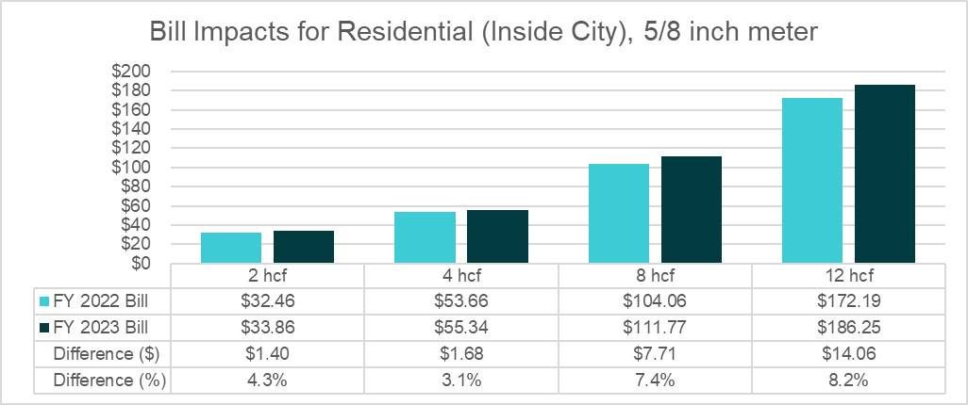
Customer Impacts

Slide 28
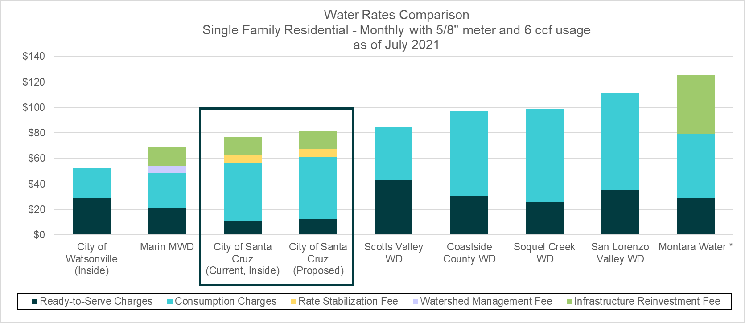
Single Family Bill Comparison
* Montara Water's "Water System Reliability Charge" is applied to the property tax annually but is shown above as applied to the monthly bill.

Slide 29
Proposed
Drought Rates

Slide 30
What are Drought Rates?
Drought rates are:
Surcharges tied to specific drought stages, as defined by the Water Storage Contingency Plan
Designed to recover lost revenue due to reduction in water usage; and
Are recovered as a fixed charge based on meter size
The proposed Drought Rates were developed using the same methodology used in the 2016 rate process
When drought stages are declared, City Council and the Water Department will implement the corresponding rates, with drought rate surcharges being collected over a full 12-month period

Slide 31
Drought Stages and Reduction
Class | Baseline | Stage 1 | Stage 2 | Stage 3 | Stage 4 | Stage 5
% of Baseline Use
SFR | 100% | 89% | 79% | 68% | 58% | 51%
MFR | 100% | 92% | 84% | 76% | 68% | 59%
Commercial | 100% | 95% | 90% | 85% | 79% | 61%
North Coast | 100% | 95% | 90% | 85% | 75% | 30%
UCSC | 100% | 91% | 81% | 72% | 62% | 55%
Irrigation | 100% | 75% | 50% | 25% | 0% | 0%
Other | 100% | 95% | 90% | 90% | 90% | 90%
Target Reduction | 0% | 10% | 20% | 30% | 40% | 50%

Slide 32
Drought Rate Calculation
Lost revenue due to drought is recovered by meter size
Larger meters have more capacity and therefore are responsible for more drought costs
Provides revenue stability for the City due to already low volume of customer use
Drought Rate | Baseline | Stage 1 | Stage 2 | Stage 3 | Stage 4 | Stage 5
Lost Revenue | $0 | $5,040,794 | $8,917,575 | $12,791,748 | $16,181,633 | $19,515,179
Equivalent Meters | 35,304 | 35,304 | 35,304 | 35,304 | 35,304 | 35,304
Drought Rate per EMU | $0.00 | $11.90 | $21.05 | $30.20 | $38.20 | $46.07

Slide 33
Drought Rate by Meter Size
Meter Size | Number of Meters | AWWA Ratio | Stage 1 | Stage 2 | Stage 3 | Stage 4 | Stage 5
5/8 inch | 21,719 | 1.00 | $11.90 | $21.05 | $30.20 | $38.20 | $46.07
3/4 inch | 498 | 1.50 | $17.85 | $31.58 | $45.30 | $57.30 | $69.10
1 inch | 1,461 | 2.50 | $29.75 | $52.63 | $75.49 | $95.49 | $115.17
1-1/2 inch | 466 | 5.00 | $59.50 | $105.25 | $150.98 | $190.98 | $230.33
2 inch | 411 | 8.00 | $95.19 | $168.40 | $241.56 | $305.57 | $368.52
3 inch | 47 | 17.50 | $208.23 | $368.37 | $528.40 | $668.43 | $806.13
4 inch | 23 | 31.50 | $374.81 | $663.06 | $951.12 | $1,203.17 | $1,451.03
6 inch | 12 | 65.00 | $773.40 | $1,368.21 | $1,962.62 | $2,482.72 | $2,994.18
8 inch | 4 | 140.00 | $1,665.79 | $2,946.91 | $4,227.17 | $5,347.40 | $6,449.00
10 inch | 3 | 210.00 | $2,498.68 | $4,420.37 | $6,340.76 | $8,021.10 | $9,673.50

Slide 34
Multi-Year Drought Rates
Drought rates for each stage are adjusted based on increase in revenues from financial plan
Proposition 218 notice will show a five-year rate schedule for each drought stage
Next slide shows the five-year schedule for Stage 2 only

Slide 35
Five-Year Drought Rates: Stage 2
Meter Size | As of 1/1/2022 | As of 7/1/23 | As of 7/1/24 | As of 7/1/25 | As of 7/1/26
5/8 inch | $21.05 | $24.47 | $28.43 | $30.39 | $32.49
3/4 inch | $31.58 | $36.70 | $42.65 | $45.59 | $48.73
1 inch | $52.63 | $61.16 | $71.07 | $75.97 | $81.21
1-1/2 inch | $105.25 | $122.31 | $142.12 | $151.92 | $162.41
2 inch | $168.40 | $195.69 | $227.39 | $243.08 | $259.85
3 inch | $368.37 | $428.05 | $497.39 | $531.71 | $568.40
4 inch | $663.06 | $770.48 | $895.30 | $957.07 | $1,023.11
6 inch | $1,368.21 | $1,589.87 | $1,847.42 | $1,974.89 | $2,111.16
8 inch | $2,946.91 | $3,424.31 | $3,979.05 | $4,253.61 | $4,547.11
10 inch | $4,420.37 | $5,136.47 | $5,968.58 | $6,380.41 | $6,820.66

Slide 36
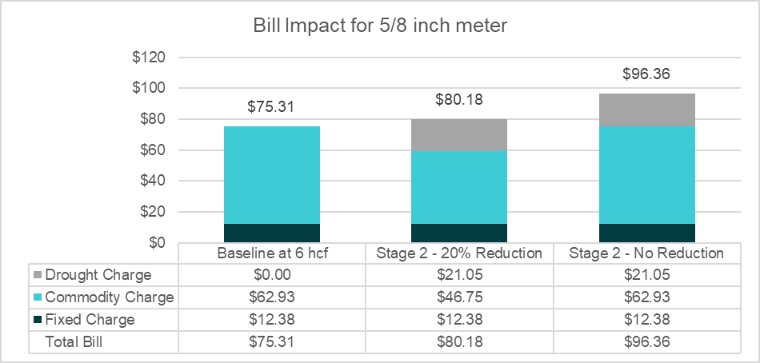
Drought Rate Impacts

Slide 37
Next Steps

Slide 38
Next Steps
Receive direction from City Council
Prepare the administrative record (report)
Important dates:
City Council meeting – September 21, 2021 (today’s meeting)
Virtual Public Meeting (Communications) – November 10, 2021
Public Hearing – November 23, 2021
Rates implemented – July 1, 2022
Proposition 218 process:
Notices sent out at least 45 days before Public Hearing
Written protests (one per parcel) must be received before end of Public Hearing

Slide 39

Thank you!
Contact:
Sanjay Gaur
213-327-4405 / sgaur@water-economics.com
Nancy Phan
626-236-0600 / nphan@raftelis.com

Slide 40
Peaking and Cost of Service
Compared to the 2016 rate study, peaking has decreased for overall water system
Irrigation customers are peaking more while most other customer classes are peaking less
Given that cost of service is a zero-sum game, peaking costs on the commodity charge will shift significantly to Irrigation accounts
Notes:
We developed a peaking analysis for the water system as well as the individual customer classes. While all other customer classes exhibited less peaking characteristics, Irrigation is the only customer class that has seen increased peaking since the analysis performed in the 2016 water rate study. Given the results of this analysis, the peaking-related costs are allocated to Irrigation customers in a higher proportion compared to the previous study.

Slide 41
RTS Charge (FY 2021 vs. COS)
Meter Size | Meters & Services | Billing & CS | COS Charge | FY 2021 Charge (Inside) | Difference ($) | Number of Meters
5/8 inch | $2.05 | $9.53 | $11.58 | $10.71 | $0.87 | 21,719
3/4 inch | $2.26 | $9.53 | $11.79 | $10.99 | $0.80 | 498
1 inch | $2.87 | $9.53 | $12.41 | $11.83 | $0.58 | 1,461
1-1/2 inch | $3.69 | $9.53 | $13.23 | $12.94 | $0.29 | 466
2 inch | $5.95 | $9.53 | $15.48 | $16.02 | ($0.54) | 411
3 inch | $22.58 | $9.53 | $32.11 | $38.71 | ($6.60) | 47
4 inch | $28.74 | $9.53 | $38.27 | $47.11 | ($8.84) | 23
6 inch | $43.10 | $9.53 | $52.63 | $66.71 | ($14.08) | 12
8 inch | $59.52 | $9.53 | $69.05 | $89.11 | ($20.06) | 4
10 inch | $78.00 | $9.53 | $87.53 | $114.32 | ($26.79) | 3
Notes:
The RTS charges shown here are revenue neutral. The meters and services component varies by meter size based on the cost to replace that meter. Billing and customer service is the same for all meter sizes: it costs the same to provide customer service and bills to any meter, regardless of size.

Slide 42
Commodity Charge (FY 2021 vs. COS)
Customer Class | Base | Water Supply | Peaking | Conserv-ation | COS Charge | FY 2021 Charge (w/o IRF) | Difference ($)
Residential
Tier 1 | $2.72 | $3.40 | $1.05 | $0.00 | $7.18 | $7.01 | $0.17
Tier 2 | $2.72 | $3.40 | $1.98 | $1.60 | $9.70 | $7.83 | $1.87
Tier 3 | $2.72 | $3.40 | $3.15 | $2.51 | $11.78 | $9.04 | $2.74
Tier 4 |  |  |  |  |  | $10.72
Commercial | $2.72 | $3.40 | $1.45 | $0.40 | $7.98 | $8.01 | ($0.03)
UCSC | $2.72 | $3.40 | $1.68 | $0.40 | $8.21 | $8.17 | $0.04
Irrigation
Tier 1 | $2.72 | $3.40 | $4.62 | $0.00 | $10.75 | $8.36 | $2.39
Tier 2 | $2.72 | $3.40 | $6.01 | $3.64 | $15.77 | $11.16 | $4.61
Tier 3 | $2.72 | $3.40 | $7.29 | $7.27 | $20.68 | $12.52 | $8.16
Notes:
The commodity charges shown here are revenue neutral and incorporate the costs of average demand, water supply, peak demand, and conservation (which is applied to the upper tiers). The FY 2021 rate used as a comparison is the commodity charge without the IRF component for Inside City customers (where applicable).

Slide 43
Commodity + IRF (FY 2021 vs. COS)
Customer Class | Operating | IRF | COS Charge | FY 2021 Charge (w/ IRF) | Difference ($)
Residential
Tier 1 | $7.18 | $1.92 | $9.10 | $9.03 | $0.07
Tier 2 | $9.70 | $3.61 | $13.31 | $10.86 | $2.45
Tier 3 | $11.78 | $5.75 | $17.53 | $12.78 | $4.75
Tier 4 |  |  |  | $15.74
Commercial | $7.98 | $2.65 | $10.63 | $10.97 | ($0.34)
UCSC | $8.21 | $3.07 | $11.28 | $11.30 | ($0.02)
Irrigation
Tier 1 | $10.75 | $8.44 | $19.19 | $12.03 | $7.16
Tier 2 | $15.77 | $10.97 | $26.74 | $16.66 | $10.08
Tier 3 | $20.68 | $13.29 | $33.97 | $18.09 | $15.88
Notes:
The first IRF option is recovered on the tiered commodity charge, which is based on the existing methodology. The capital costs are allocated to each customer based on the peaking characteristics specific to each class and tier.

Slide 44
Proposed Commodity Charges
Customer Class | Proposed FY 2023 Charge | Current FY 2022 Charge | Difference ($)
Residential
Tier 1 | $7.37 | $7.68 | $0.31
Tier 2 | $8.24 | $10.37 | $2.13
Tier 3 | $9.51 | $12.60 | $3.09
Tier 4 | $11.28
Commercial | $8.43 | $8.53 | $0.10
UCSC | $8.60 | $8.78 | $0.18
Irrigation
Tier 1 | $8.80 | $11.50 | $2.70
Tier 2 | $11.74 | $16.86 | $5.12
Tier 3 | $13.17 | $22.11 | $8.94
Notes:
The commodity charges shown here compare the COS (revenue neutral) rate, the proposed FY 2023 charge with revenue adjustments applied, and the current FY 2022 rates. Note that these commodity charges include only the O&M component (no IRF).

Slide 45
Rate Components for North Coast Ag
There are three rate components:
RTS Charge: Fixed by Meter Size
Operating Commodity Charge: Uniform Volumetric
Capital IRF: Uniform Volumetric
RTS Charge for North Coast Ag is the same as all other customers and the same for both reliability options

Slide 46
Ag Reliability Options – Operating Costs
Water supply-related costs are recovered to provide raw water to customers
Maintain reliability – Ag customers are charged like all other customers
Decreased reliability – Ag customers are charged based on proportion of water supply from North Coast system (25%)
Proportional share of North Coast Ag Cost
Water Supply O&M | Maintain | Decrease
Water Engineering and Capital | Yes | Yes
Water Resources | Yes | Some
Raw Water Production | Yes | Some
Loch Lomond | Yes | No
% of Costs to Include for Ag | 100% | 22%
Notes:
Decreased:
Water Resources: 25% (based on proportion of water supply from NC system)
Raw Water Production: 25% (based on proportion of water supply from NC system)

Slide 47
Operating Commodity Charge Components
Commodity Cost Components | Included for North Coast Ag Customers? | Included for All Other Customers?
Raw Water Delivery | Yes | Yes
Treated Water Delivery | No | Yes
Water Supply | Yes (maintain) / Some (decrease) | Yes
Raw Water Peaking | Yes | Yes
Treated Water Peaking | No | Yes
Conservation | Yes | Yes

Slide 48
Ag Reliability Options – Capital Costs
IRF recovers capital needs and are allocated based on asset benefit
Maintain reliability – Ag customers are not charged for assets that are not used (treatment, some general)
Decreased reliability – Ag customers are only charged for assets related to the North Coast system
Capital Assets | Maintain | Decrease
Raw Water Pumping | Yes | No
Raw Water Storage | Yes | Some
Raw Water Transmission | Yes | Some
Treated Water Assets | No | No
Customer Service | Yes | Yes
Meters | Yes | Yes
Fire Protection | No | No
Land | Yes | Yes
General | Some | Some
% of Assets to Include for Ag | 25% | 12%
Notes:
Decreased:
Raw Water Storage: 6%
Raw Water Transmission: 58% (based on proportion of LF of pipeline in NC system)
General: 61%

Slide 49
Proposed Rates – Commodity + IRF
Reliability Options | Current FY 2022 Charge | Proposed FY 2023 Charge | Difference ($)
Commodity + IRF
Maintain Reliability | $8.98 | $6.45 | ($2.53)
Decreased Reliability | $8.98 | $2.88 | ($6.10)
North Coast Ag rates are decreasing from current because:
Decrease in annual use (27,000 hcf vs. 9,700 hcf)
Decrease in peaking (1.83 peak vs. 1.78 peak)
Proposed methodology for IRF allocation (based on assets vs. capacity)

Slide 50
Use by Class and Drought Stage
Class | Baseline | Stage 1 | Stage 2 | Stage 3 | Stage 4 | Stage 5
SFR | 1,201,100 | 1,068,979 | 948,869 | 816,748 | 696,638 | 612,561
MFR | 753,196 | 692,940 | 632,685 | 572,429 | 512,173 | 444,386
Commercial | 799,242 | 759,280 | 719,318 | 679,356 | 631,401 | 487,538
North Coast | 9,713 | 9,227 | 8,742 | 8,256 | 7,285 | 2,914
UCSC | 225,428 | 205,139 | 182,597 | 162,308 | 139,765 | 123,985
Irrigation | 157,725 | 118,294 | 78,863 | 39,431 | 0 | 0
Other | 73,190 | 69,531 | 65,871 | 73,190 | 73,190 | 73,190
Total | 3,219,594 | 2,923,390 | 2,636,943 | 2,351,718 | 2,060,453 | 1,744,574
% Reduction | 0.0% | 9.2% | 18.1% | 27.0% | 36.0% | 45.8%

Slide 51
Estimated Commodity Revenue
Class | Baseline | Stage 1 | Stage 2 | Stage 3 | Stage 4 | Stage 5
SFR | $13,910,634 | $11,439,666 | $9,730,501 | $7,955,126 | $6,785,254 | $5,966,344
MFR | $7,625,844 | $6,749,239 | $6,162,348 | $5,575,458 | $4,988,568 | $4,328,316
Commercial | $9,087,382 | $8,633,012 | $8,178,643 | $7,724,274 | $7,179,031 | $5,543,303
North Coast | $62,649 | $59,516 | $56,384 | $53,252 | $46,987 | $18,795
UCSC | $2,720,916 | $2,476,034 | $2,203,942 | $1,959,059 | $1,686,968 | $1,496,504
Irrigation | $3,377,800 | $2,428,571 | $1,619,047 | $809,524 | $0 | $0
Other | $832,170 | $790,562 | $748,953 | $832,170 | $832,170 | $832,170
Total | $37,617,394 | $32,576,599 | $28,699,819 | $24,908,863 | $21,518,978 | $18,185,432
Lost Revenue |  | $5,040,794 | $8,917,575 | $12,708,531 | $16,098,416 | $19,431,962

Slide 52
Cost of Service Analysis
“Revenue neutral” requirement is $39.3 million
$9 million or 23% is for infrastructure/capital-related costs
Does not include Rate Stabilization Fee revenues
No differential between Inside and Outside City rates
Currently Outside City pays 14.5% surcharge
Based on a prior analysis (all else equal), Inside will go up ~4% and Outside will decrease by ~8%
Notes:
Based on FY 2019 customer data and FY 2021 water rates, the total rate revenues less Rate Stabilization Fee revenues is equal to $39.3 million. $9 million of this revenue requirement is related to infrastructure or capital related costs and is equal to the amount of cash funded capital plus debt service. The preliminary rates do not have a rate differential between Inside and Outside City customers – meaning that Inside City customers' rates will increase and Outside City customers' rates will decrease based on this change.

Slide 53
Do we need this?
The preliminary results in this presentation are based on the cost of service (COS) analysis, which is:
Revenue neutral (collects same amount of revenue as current rates)
Cost of service analysis utilizes the FY 2021 Budget
Based on customer consumption data from FY 2019
The COS rates are based on the above assumptions
Financial requirements are then layered onto the COS rates
Rates will be increased across the board based on required revenue adjustments
Notes:
To start evaluating rate structure options, preliminary rates were developed for two scenarios. One of the scenarios is revenue neutral and based on FY 2021 rates and FY 2019 customer data (the "representative year" of data, determined during the kick-off meeting of this study). The financial requirements developed by city staff and use the PFM financial model and pro forma results (See Draft Long Range Financial Plan). These forward-looking revenue requirements used for developing rates for the proposed FY 2023 through FY 2027 period.

Slide 54
Ag Reliability – Operating and Capital
Operating costs -- Water supply-related costs related to providing raw water to North Coast Ag customers:
Maintain reliability – cost basis for Ag is the same as all other customers and includes its proportionate share of operating costs for raw water storage and infrastructure facilities, including the San Lorenzo, North Coast and Beltz wellfield sources.
Decreased reliability – cost basis for Ag is the proportionate share of operating costs for the North Coast sources and facilities
Capital costs (IRF)
Maintain reliability – cost basis for Ag is the same as all other customers and includes its proportionate share of capital costs associated with all raw water storage and infrastructure facilities, including the San Lorenzo, North Coast and Beltz wellfield sources.
Decreased reliability – cost basis for Ag is the proportionate share of capital costs for the North Coast sources and facilities – other costs aren’t relevant due to the interruptible nature of this level of service.

Slide 55
Proposed 5-Year Rate Schedule
North Coast Ag | Current FY 2022 Charge | Proposed FY 2023 Charge | Proposed FY 2024 Charge | Proposed FY 2025 Charge | Proposed FY 2026 Charge | Proposed FY 2027 Charge
Commodity + IRF
Maintain Reliability | $8.98 | $6.45 | $7.51 | $8.74 | $9.35 | $10.00
Decrease Reliability | $8.98 | $2.88 | $3.36 | $3.92 | $4.20 | $4.50
RTS Charge for North Coast Ag is the same as all other customers and the same for both reliability options
North Coast Ag customers have expressed a preference for the maintain reliability option based on August 3, 2021 meeting
Notes:
This slide shows the five-year rate schedule for commodity charges under the IRF tiered commodity option. The proposed charges from FY 2023 through FY 2027 are based on the total revenue adjustments previously shown, which are applied to the COS rates.

Slide 56
Changes to North Coast Ag Rate
North Coast Ag rates are decreasing from current due to:
Reduction in annual use (27,000 hcf vs. 9,700 hcf)
Decreased peaking (1.83 vs. 1.78)
Proposed methodology for IRF allocation (based on asset benefit vs. capacity)
Better asset data was available for this study, so methodology can be refined based on asset benefit

